Slide 1



VDLB 2026 Tutorial
Interoperability in Healthcare: A Primer and New Frontiers

Slide 2




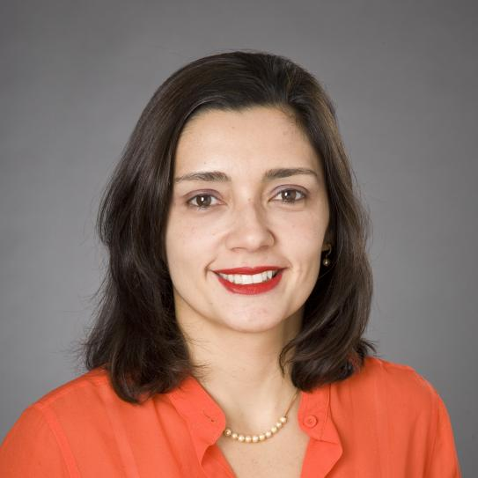
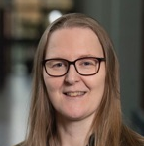
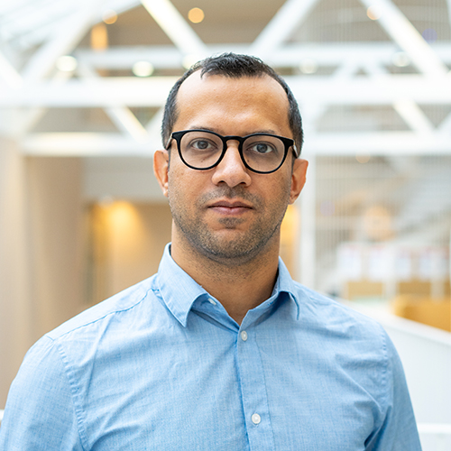
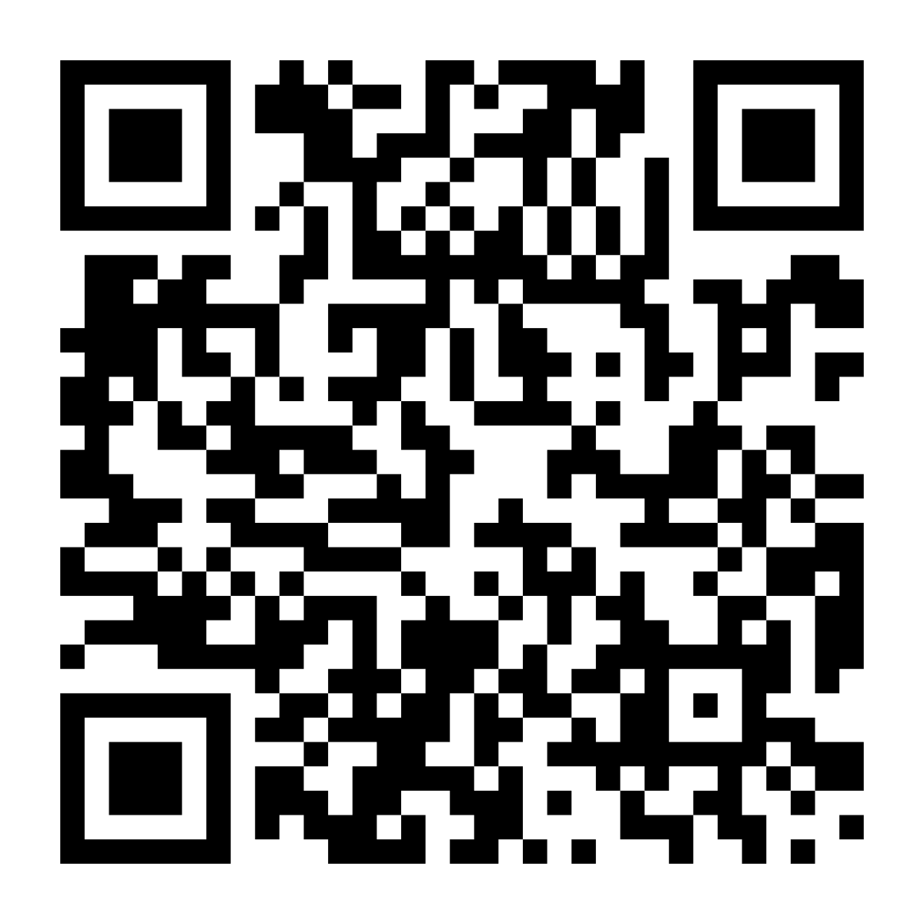
Speakers
Andra Ionescu
Paris Carbone
Sebastiaan Meijer
Christos Koutras
KTH Royal Institute of Technology
KTH Royal Institute of Technology
KTH Royal Institute of Technology
New York University
Juliana Freire
Katja Hose
Jayanth Raghothama
New York University
TU Wien
KTH Royal Institute of Technology
Scan for slides

Slide 3
Agenda
01
Overview
Context and goals for the session
02
Approach
Methods and the framework we apply
03
Scan for slides
Findings
Key results, data, and what they mean
https://interoperability-tutorial.lovable.app/
04
Next steps
Recommendations and open questions
KTH / NYU / TU Wien
Agenda
2

Slide 4
1
SECTION 01
First Generation
Proprietary silos — the starting point of the story.
KTH / NYU / TU Wien

Slide 5
2
SECTION 02
Second Generation
Standards-based interchange between systems.
KTH / NYU / TU Wien

Slide 6
3
SECTION 03
Third Generation
Information-model-first architectures.
KTH / NYU / TU Wien

Slide 7




Four pillars
Research
Education
Innovation
Collaboration
Curiosity-driven inquiry across disciplines and labs.
Teaching that equips students for tomorrow.
Turning ideas into practical, real-world solutions.
Partnerships with industry, society, and academia.
KTH / NYU / TU Wien
Four pillars
4

Slide 8
By the numbers
A combined identity, three voices
This template keeps each institution legible while presenting one coherent surface. Blues carry the structure, violet adds depth, and magenta is reserved as a sharp accent — used sparingly.
3
6
institutions, one deck
core brand colors
2027
13
KTH identity rollout
ready-made slide layouts
KTH / NYU / TU Wien
By the numbers
5

Slide 9
Data slide
Native, editable charts using the combined palette.
KTH / NYU / TU Wien
Data slide
6

Slide 10

Process
1
2
3
4
STEP 1
STEP 2
STEP 3
STEP 4
Discover
Design
Deliver
Refine
Frame the question
Build the approach
Run and measure
Iterate on results
KTH / NYU / TU Wien
Process
7

Slide 11

FIRST GENERATION
Point One
Point One
The headline idea for this point goes here
Lead with the key claim, then support it.
Keep each bullet to one idea so the breadcrumb above stays meaningful.
The header shows the audience exactly where they are: section, then point.
Supporting visual, chart, or image
KTH / NYU / TU Wien
First Generation
8

Slide 12
FIRST GENERATION
Point Three
Point Three
Two completed points behind, two still ahead
What it is
Why it matters
A short definition or framing of this point.
The consequence or stake for the audience.
Evidence
Takeaway
Data, example, or citation that backs it.
The one thing to remember from this point.
KTH / NYU / TU Wien
First Generation
9

Slide 13
KTH / NYU / TU Wien
“
Good design makes three identities read as one intention — structured, warm, and confident.
Quote attribution
Title · Institution

Slide 14
KTH / NYU / TU Wien
Thank you
Questions and discussion welcome.
name@institution.edu
KTH · NYU · TU Wien

