Slide 1



VDLB 2026 Tutorial
Interoperability in Healthcare: A Primer and New Frontiers

Slide 2
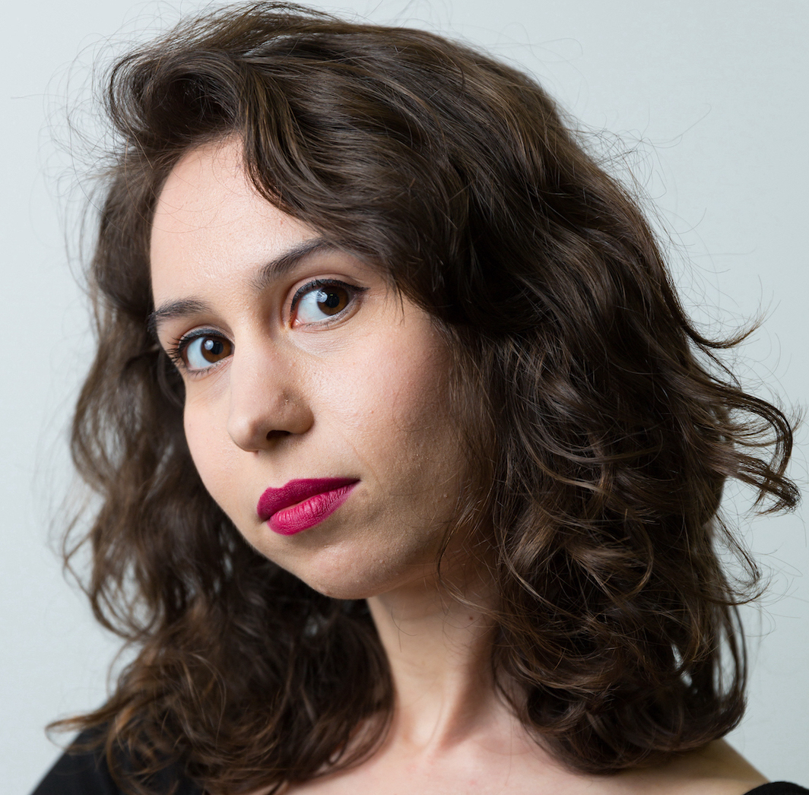

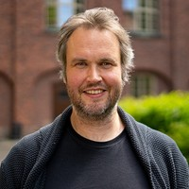

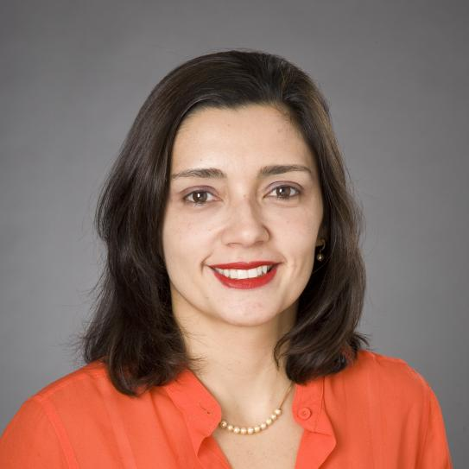
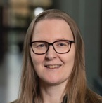
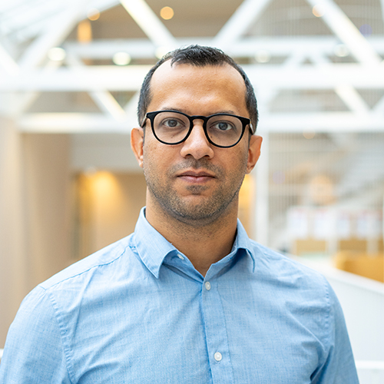
Who are we?
Andra Ionescu
Paris Carbone
Sebastiaan Meijer
Christos Koutras
KTH Royal Institute of Technology, Sweden
KTH Royal Institute of Technology, Sweden
KTH Royal Institute of Technology, Sweden
New York University, USA
Juliana Freire
Katja Hose
Jayanth Raghothama
New York University, USA
TU Wien, Austria
KTH Royal Institute of Technology, Sweden

Slide 3

Agenda
01
Intro & First Generation
Motivation, Interoperability, How it started
02
Second Generation
Standards and Challenges
Scan for slides
03
Third Generation
LLMs, Graphs, Interactive Harmonisation
https://tutorial.mediverse.se/
04
The New Frontier
Open Questions and Future Work
KTH / NYU / TU Wien
3

Slide 4
1
PART 01
Motivation
Andra Ionescu, Jayanth Raghothama
KTH / NYU / TU Wien

Slide 5
Why now?
GOALS FOR THIS TUTORIAL
PAST TUTORIAL · VLDB 2012
14 years since we last talked about it
1
2
Interoperability in healthcare has developed considerably since
Map today's standards landscape
Share the HI challenges and DM solutions
WHAT IT COVERED
EHR, PHR & device interoperability
Integrating Healthcare Enterprise (IHE) profiles
3
4
Deployment: Turkey's National EHR system
THIS TUTORIAL
Share real deployments & lessons
Chart the future direction
Here’s what we want to achieve with this tutorial:
Dogac, Asuman. "Interoperability in eHealth systems." Proceedings of the VLDB Endowment 5.12 (2012): 2026-2027.
KTH / NYU / TU Wien
Andra Ionescu
5

Slide 6
KTH / NYU / TU Wien
“
Interoperability is the ability of two or more systems or components to exchange information and to use the information that has been exchanged.
IEEE Standard Computer Dictionary: A Compilation of IEEE Standard Computer Glossaries
https://ieeexplore.ieee.org/document/182763

Slide 7


Slide 8

Interoperability
The Healthcare Information and Management Systems Society (HIMSS) defines four levels of interoperability
Technical
Syntactic
Semantic
Organizational
Establishes the inter-connectivity requirements to exchange data
Concerns the format and structure in which data is encoded and exchanged
Concerns the ability to share meaning across systems
Includes governance, policy, social, legal and organizational considerations
KTH / NYU / TU Wien
Jayanth Raghothama
8

Slide 9
Interoperability
Key Challenge:
The epistemology of clinical practice is not the same as the information (domain) model that captures it in data systems.
In other words:
No agreement on the semantics (common domain models)
Which leads to:
No base ontology of epistemic entities (observations, etc.) which can be instantiated as an information model
1
Technical: Solved
Syntactic: Solved
3
Semantic:
Addressed through standards
Organizational: Not even close
KTH / NYU / TU Wien
Jayanth Raghothama
9

Slide 10
Semantic Interoperability
For complex domains, semantics are key:
  The information model that captures an episode of a blood pressure reading of a patient is not the same as the ontological description of blood pressure
The meaning of data needs to be unambiguously exchanged, and understood by the receiver (system and user), without special measures
Interoperability (semantic) needs to be an emergent phenomenon of underlying common domain models, not ad-hoc reengineering of endless specifications (current scenario)
Ref: Stenzhorn et.al. 2008
KTH / NYU / TU Wien
Jayanth Raghothama
10

Slide 11
Interoperability
Secondary Challenges:
Legacy systems
Proliferation of vocabularies and terminologies
Poor adherence to standards and terminologies
Closed and proprietary information models
Variance in clinical practice, cultures and demographics (perhaps not something to be "solved")
1
Technical: Solved
Syntactic: Solved
3
Semantic:
Addressed through standards
Organizational: Not even close
Ref: Beale et.al 2022
KTH / NYU / TU Wien
Jayanth Raghothama
11

Slide 12
1
PART 01
First Generation
Jayanth Raghothama
KTH / NYU / TU Wien

Slide 13
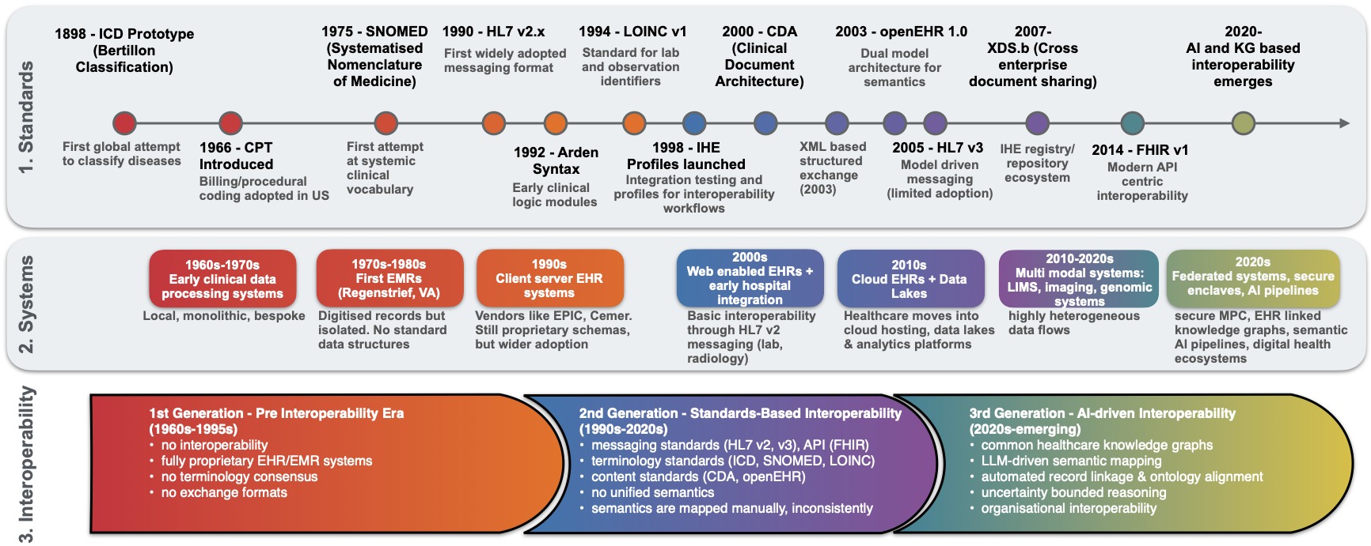
History
KTH / NYU / TU Wien
Jayanth Raghothama
13

Slide 14
FIRST GENERATION
Informatics Models
Predate computers …
Jean Fernel, produced the first recognised classification of diseases structured according to contemporary principles of scientific empiricism in the Universa Medicina, published in 1554
Carolus Linnaeus (famed for his botanical taxonomy) also classified the animal and mineral kingdoms, and attempted the same for diseases
KTH / NYU / TU Wien
Jayanth Raghothama
14

Slide 15
FIRST GENERATION
19th Century Statistics
First attempts at structured vocabularies
1839. First Classification of Mortalities, culminating in the International List of Causes of Death (ILCD)
ILCD was systematically expanded by Jacques Bertillon into a classification: Bertillon Classification of Causes of Death (1880s – 1890s)
Adopted by the WHO in 1948 to become ICD-6
KTH / NYU / TU Wien
Jayanth Raghothama
15

Slide 16
FIRST GENERATION
First Computer Systems
1955 – 1970s: Foundations of the modern EHR
MUMPS, otherwise known as the Massachusetts General Hospital Utility Multi-Programming System.
Problem-Oriented Medical Records (POMR) that changed how doctors recorded patient interactions.
KTH / NYU / TU Wien
Jayanth Raghothama
16

Slide 17
FIRST GENERATION
First Computer Systems
1970s – 1995: Foundations of the modern EHR
EPIC Cosmos
SNOMED-CT in 1975
Slow development of other standards: LOINC, CPT
Transition from National Databases (e.g. Medline) to Site-Level (provider) Systems
Proprietary Information Models, leading to a sprawl of Information Models.
KTH / NYU / TU Wien
Jayanth Raghothama
17

Slide 18

SECOND GENERATION
SOTA early 21st Century
• Rapid acceleration in Digitalization of medical records and health systems, spurred on by large government investments
• Vendors gain prominence, such as Epic and Cerner, with proprietary information models
• Shift towards web-based systems starts
• Interoperability becomes a concern:
  Standards based interoperability: imposition of semantics top-down
  More standards developed
KTH / NYU / TU Wien
Jayanth Raghothama
18

Slide 19
2
PART 02
Second Generation
Andra Ionescu
KTH / NYU / TU Wien

Slide 20
History
KTH / NYU / TU Wien
Andra Ionescu
20
Notes:
Blurr the rest so we have a focus area

Slide 21
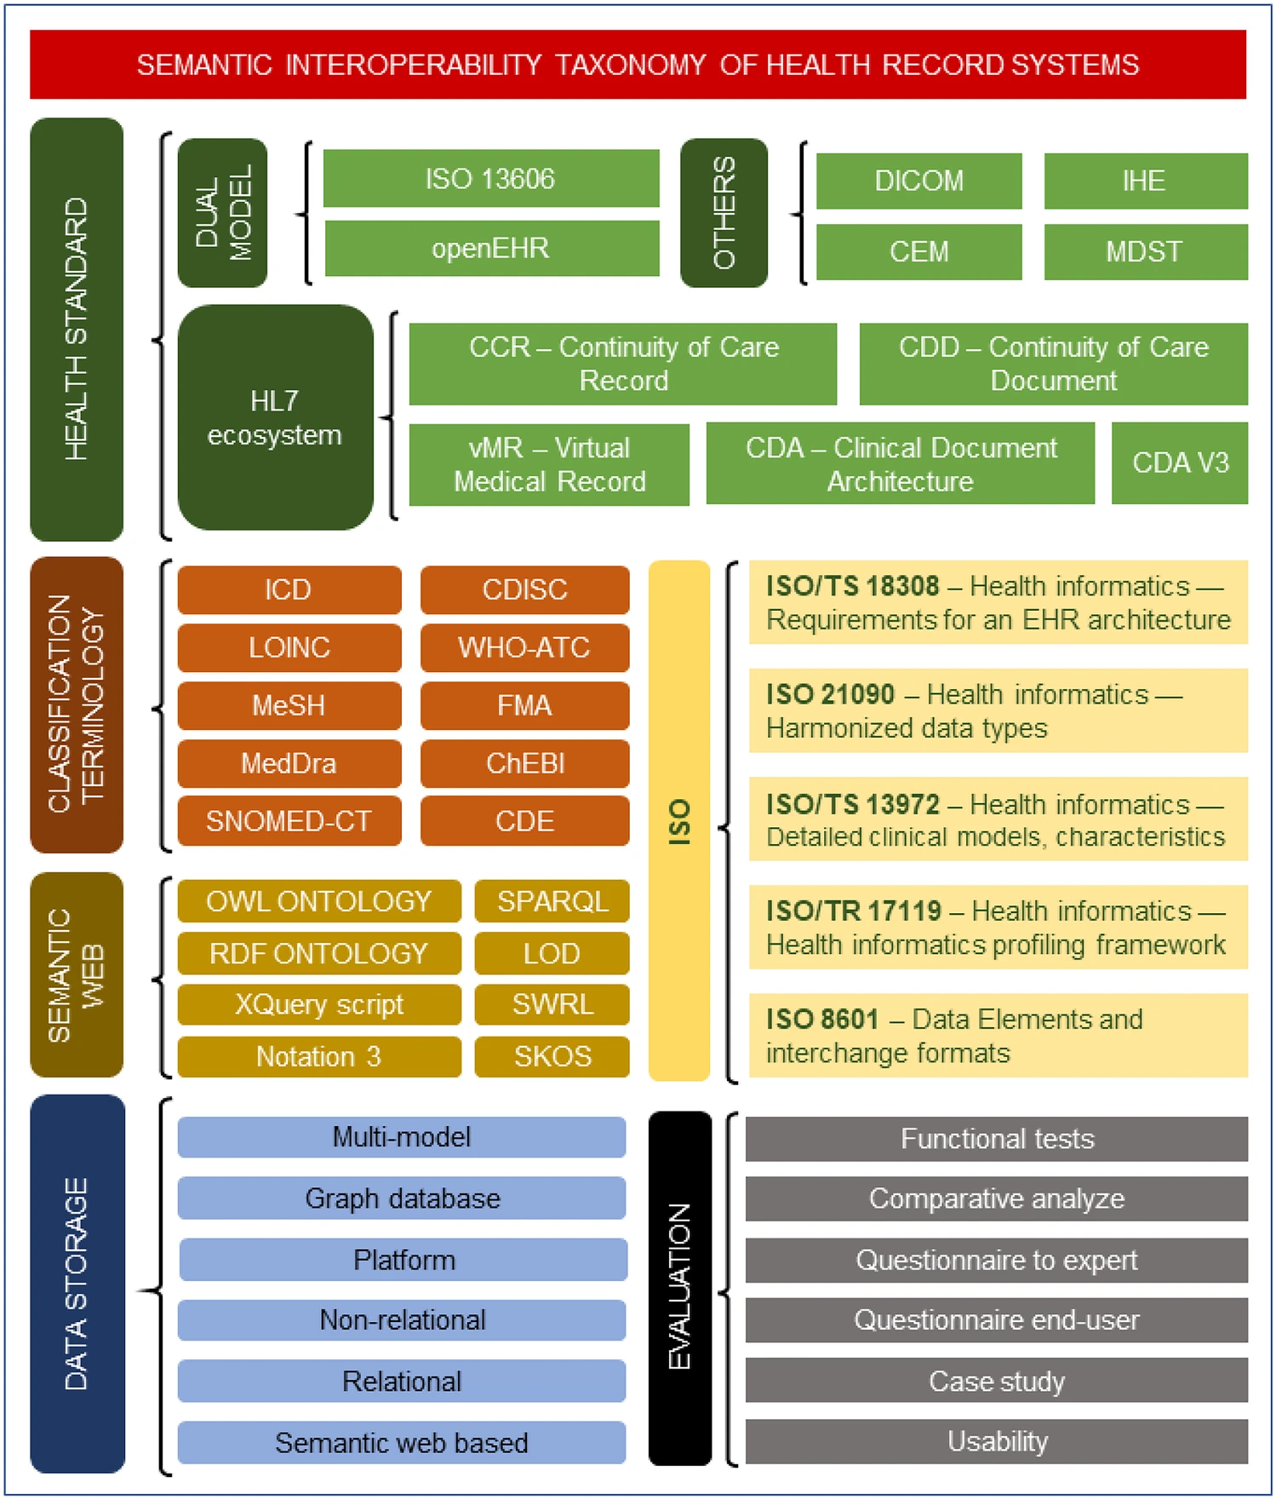
Taxonomy
Interoperability works by conforming to standards
Else, N connectors need to be developed to communicate with the different systems
However, there is no global consensus for standards
de Mello, B.H., Rigo, S.J., da Costa, C.A. et al. Semantic interoperability in health records standards: a systematic literature review. Health Technol. 12, 255–272 (2022).
KTH / NYU / TU Wien
Andra Ionescu
21
Notes:
Add a slide to explain the terms: info models, exchange, what is the difference between CDM and info models
Spend more time on here to explain what they mean
Info models highlight the epistemology of the knowledge

Slide 22
Taxonomy
Exchange Standards
How data is serialised and transmitted between systems (aka a messaging protocol, the serialisation)
Information (domain) Models
How clinical information is structured, a conceptual logical model (aka the schema)
Common Data Models
Subclass of Information Models
It is standardised as a shared target across institutions (aka a mediated schema)
Terminology Systems
Standardised vocabulary of clinical meanings
Defines the content (e.g., instance-level)
Referenced ontology
KTH / NYU / TU Wien
Andra Ionescu
22

Slide 23
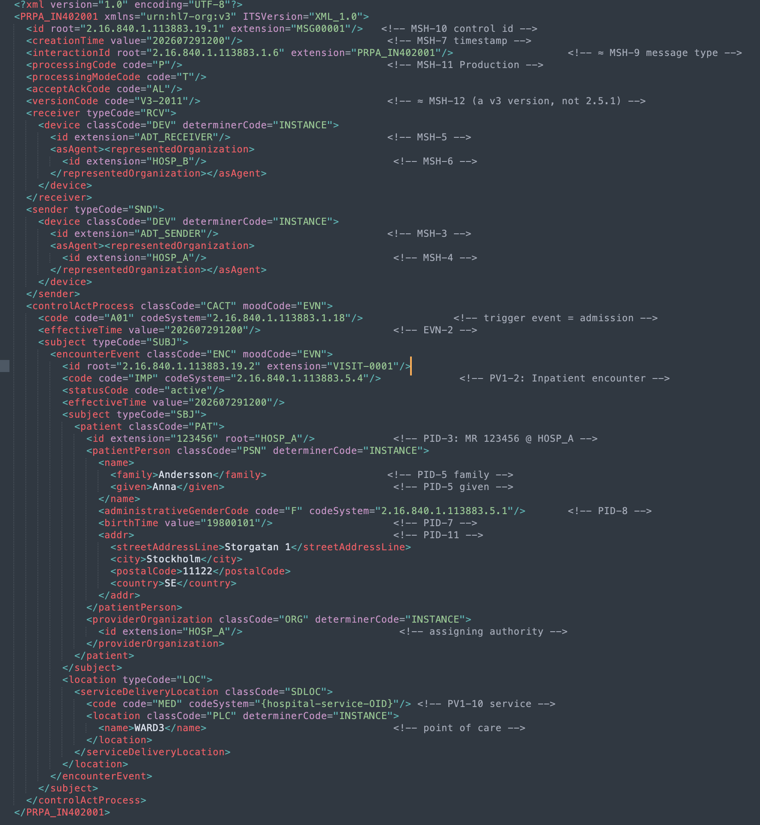
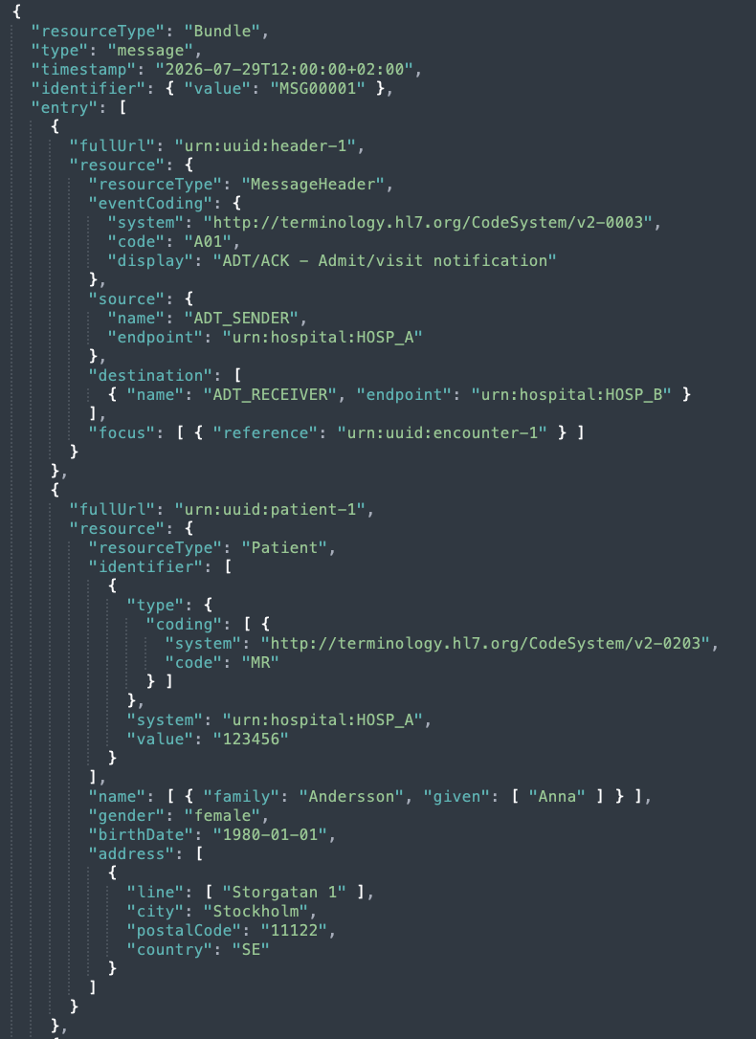
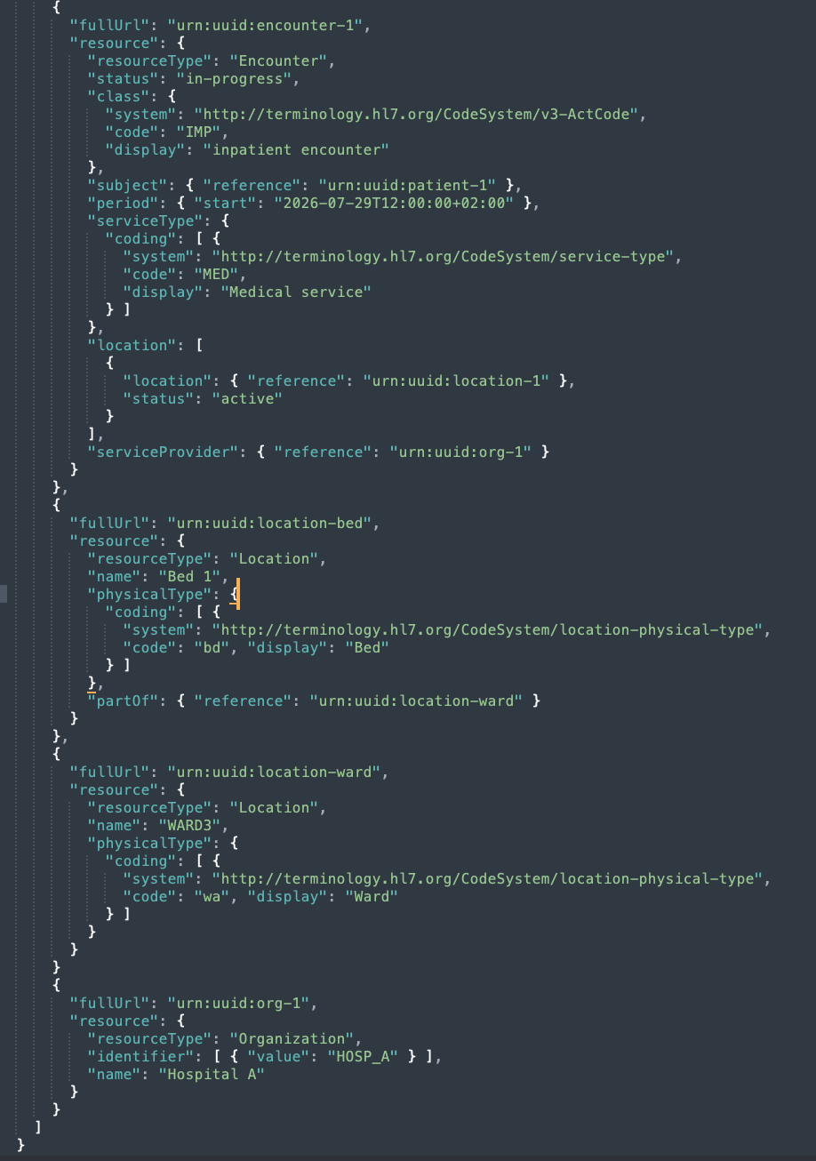





SECOND GENERATION
Message Exchange Standards
Health Level Seven (HL7) – exchanging clinical and administrative data between healthcare systems
Deployed 1987 — the most deployed standard in the world
Deployed 2005 — built based on a Reference Information Model (RIM) and encoded in XML
Fast Healthcare Interoperability Resources — released in 2014
v2 example
Pipe-and-hat delimited syntax, lots of optional fields, very flexible
Complex, rigid: data had to be encoded based on RIM Act-Role-Entity-Participation backbone
•
Combines the strengths of v2 and v3
•
MSH|^~\&|ADT_SENDER|HOSP_A|ADT_RECEIVER|HOSP_B|202607291200||ADT^A01|MSG00001|P|2.5.1
EVN|A01|202607291200
PID|1||123456^^^HOSP_A^MR||Andersson^Anna^^^||19800101|F|||Storgatan 1^^Stockholm^^11122^SE
PV1|1|I|WARD3^301^1|||||||MED||||ADM
!
•
Explicit semantics: breaks data into 157 resources (e.g., Patient, Observation, Condition)
•
Legacy protocol, still used nowadays
!
Hard to implement in hospital workflows
Limited semantic meaning, implied data model, bespoke interfaces, not scalable
!
Not backwards compatible with v2
•
Sends data as JSON/XML over REST APIs
!
Not used anymore, demanded too many resources vs ROI
Flexibility is an issue: extra fields need data processing
!
!
Semantic challenge: mapping data to FHIR resources
!
KTH / NYU / TU Wien
Andra Ionescu
23
Notes:
So might wonder why am I presenting this? Why are they relevant? Well, because they are actually used to send data between hospitals for example. So what we see here, is a mapping problem. The mappings between the datasets and the exchange standards are done manually.
There is a dominant exchange standard but it doesn’t solve interop.

Slide 24
SECOND GENERATION
Message Exchange Standards
WHY?
Two systems that are built completely independent from each other agree on a data representation that can be sent and received
They don’t have to know the internal schema, the message just needs to adhere to the standardised format
!
Mapping problem: mappings are manually defined
!
Data loss: not all data can be sent
!
Semantic problem: the sender doesn’t know if the receiver understands the data
KTH / NYU / TU Wien
Andra Ionescu
24
Notes:
So might wonder why am I presenting this? Why are they relevant? Well, because they are actually used to send data between hospitals for example. So what we see here, is a mapping problem. The mappings between the datasets and the exchange standards are done manually.
There is a dominant exchange standard but it doesn’t solve interop.

Slide 25
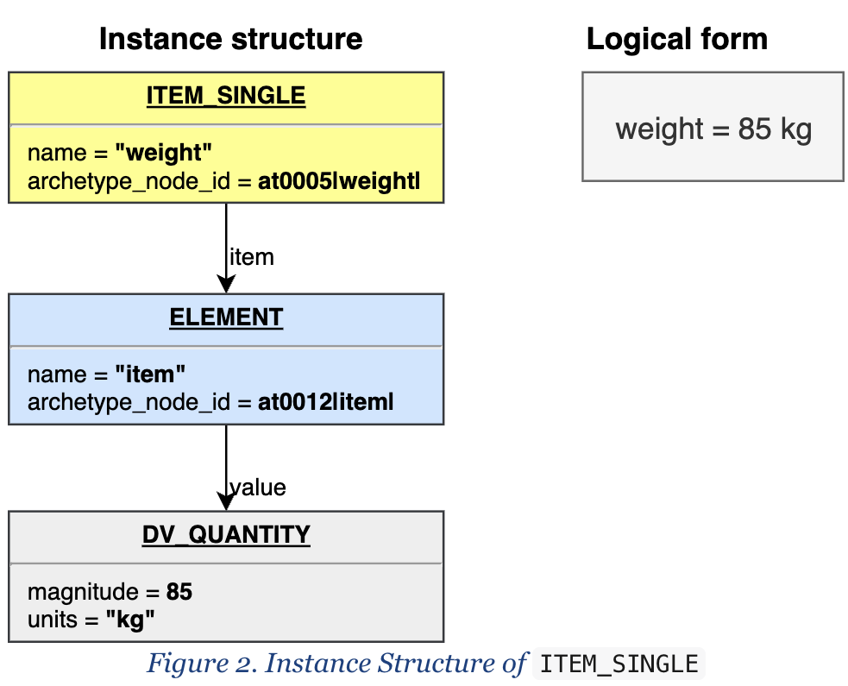
SECOND GENERATION
Information Models
openEHR
• An architecture to store, version and query EHR
• Captures the epistemic role of data, it is the closest model to clinical practice, similar to how clinicians think
• It is based on a very strict Reference Model that contains data types (SECTION, ENTRY, CLUSTER, ELEMENT, etc)
!
High complexity: modelling data before storing
https://specifications.openehr.org/releases/RM/Release-1.1.0/data_structures.html
KTH / NYU / TU Wien
Andra Ionescu
25
Notes:
Modelling the data
Difference between openehr – is the closest model to clinical practice
RM is very strict
Archetype is the information flow – similar to how clinicians think
What each of the standard solves?
Every step loses some information
None of them represent how clinicians work
What does it mean for healthcare? What does it mean for the doctor, the patient? Why are we doing this? – conclusion

Slide 26
Blood Pressure Example
Example: 120/80 mmHg, taken 2026-07-29, patient id 42, during visit 5001
openEHR
OBSERVATION: Blood pressure [openEHR-EHR-OBSERVATION.blood_pressure.v2]
└─ data: HISTORY
└─ events[0]: POINT_EVENT "Any event" @ 2026-07-29T12:00:00
├─ data (ITEM_TREE) ← the measured values
│ ├─ ELEMENT at0004 "Systolic" = 120 mm[Hg] (DV_QUANTITY)
│ └─ ELEMENT at0005 "Diastolic" = 80 mm[Hg] (DV_QUANTITY)
└─ state (ITEM_TREE) ← condition at time of measurement
└─ ELEMENT at0008 "Position" = Sitting (DV_CODED_TEXT)
└─ protocol (ITEM_TREE) ← how it was measured
├─ ELEMENT at1007 "Cuff size" = Adult
└─ ELEMENT at1008 "Location" = Right arm (DV_CODED_TEXT)
KTH / NYU / TU Wien
Andra Ionescu
26
Notes:
Modelling the data

Slide 27
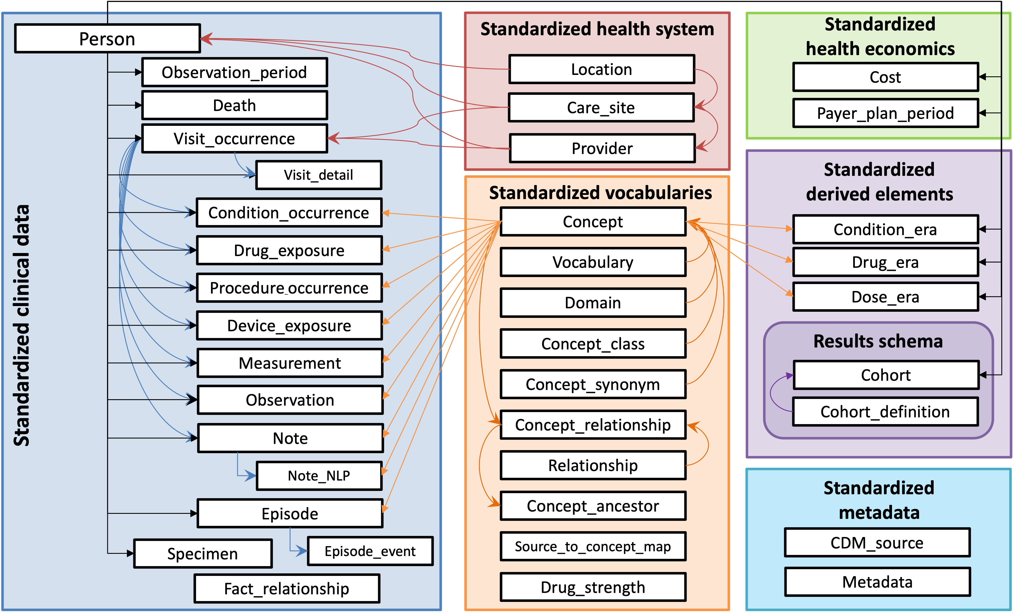
SECOND GENERATION
Information Models
OMOP
Observational Medical Outcomes Partnership
• Relational schema with standardised tables
• Clinical facts mapped to a concept_id from OMOP’s Standardised Vocabularies
• Built for longitudinal, population-scale analysis
!
Not an exchange nor a persistence standard
https://ohdsi.github.io/CommonDataModel/
KTH / NYU / TU Wien
Andra Ionescu
27

Slide 28
Blood Pressure Example
Example: 120/80 mmHg, taken 2026-07-29, patient id 42, during visit 5001
OMOP
MEASUREMENT table
23 columns
measurement_id,person_id,measurement_concept_id,measurement_date,measurement_datetime,measurement_time,measurement_type_concept_id,operator_concept_id,value_as_number,value_as_concept_id,unit_concept_id,range_low,range_high,provider_id,visit_occurrence_id,visit_detail_id,measurement_source_value,measurement_source_concept_id,unit_source_value,unit_source_concept_id,value_source_value,measurement_event_id,meas_event_field_concept_id
1001,42,3004249,2026-07-29,2026-07-29 12:00:00,12:00:00,32817,,120,,8876,90,120,,5001,,8480-6,3004249,mmHg,8876,120,,
1002,42,3012888,2026-07-29,2026-07-29 12:00:00,12:00:00,32817,,80,,8876,60,80,,5001,,8462-4,3012888,mmHg,8876,80,,
KTH / NYU / TU Wien
Andra Ionescu
28
Notes:
Modelling the data

Slide 29
Blood Pressure Example
Example: 120/80 mmHg, taken 2026-07-29, patient id 42, during visit 5001
OMOP
MEASUREMENT table
23 columns
measurement_id,person_id,measurement_concept_id,measurement_date,measurement_datetime,measurement_time,measurement_type_concept_id,operator_concept_id,value_as_number,value_as_concept_id,unit_concept_id,range_low,range_high,provider_id,visit_occurrence_id,visit_detail_id,measurement_source_value,measurement_source_concept_id,unit_source_value,unit_source_concept_id,value_source_value,measurement_event_id,meas_event_field_concept_id
1001,42,3004249,2026-07-29,2026-07-29 12:00:00,12:00:00,32817,,120,,8876,90,120,,5001,,8480-6,3004249,mmHg,8876,120,,
1002,42,3012888,2026-07-29,2026-07-29 12:00:00,12:00:00,32817,,80,,8876,60,80,,5001,,8462-4,3012888,mmHg,8876,80,,
KTH / NYU / TU Wien
Andra Ionescu
29
Notes:
Modelling the data

Slide 30

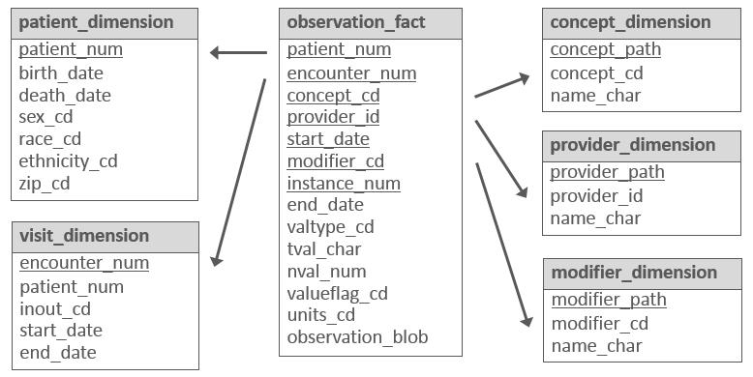
SECOND GENERATION
Information Models
i2b2
Informatics for Integrating Biology and the Bedside
• Common data model for data warehouse development
• Star schema with one large fact table of atomic observations with dimension tables
!
Narrow analytic scope: cohort discovery
i2b2 star schema — fact table with dimension tables (https://i2b2.atlassian.net/wiki/spaces/BUN/pages/207290415/)
https://freepngimg.com/png/104629-picture-r2-d2-free-transparent-image-hd/icon
KTH / NYU / TU Wien
Andra Ionescu
30

Slide 31
Blood Pressure Example
Example: 120/80 mmHg, taken 2026-07-29, patient id 42, during visit 5001
i2b2
OBSERVATION_FACT table
22 columns
encounter_num,patient_num,concept_cd,provider_id,start_date,modifier_cd,instance_num,valtype_cd,tval_char,nval_num,valueflag_cd,quantity_num,units_cd,end_date,location_cd,confidence_num,observation_blob,update_date,download_date,import_date,sourcesystem_cd,upload_id
5001,42,LOINC:8480-6,@,2026-07-29 12:00:00,@,1,N,E,120,,,mmHg,2026-07-29 12:00:00,,,,2026-07-29,2026-07-29,2026-07-29,EHR,1
5001,42,LOINC:8462-4,@,2026-07-29 12:00:00,@,1,N,E,80,,,mmHg,2026-07-29 12:00:00,,,,2026-07-29,2026-07-29,2026-07-29,EHR,1
KTH / NYU / TU Wien
Andra Ionescu
31
Notes:
Modelling the data

Slide 32
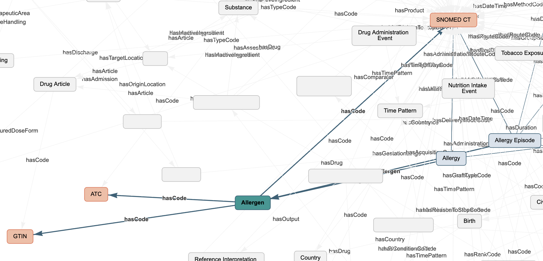
SECOND GENERATION
Information Models
SPHN
Swiss Personalized Health Network
• A secondary-use semantic interoperability framework
• RDF knowledge graph
• Can represent information beyond common data models, such as questionnaires
!
National adoption - more challenging to understand and use because of RDF
RDF knowledge graph — how SPHN data looks as a graph (https://schemascope.dcc.sib.swiss/)
KTH / NYU / TU Wien
Andra Ionescu
32

Slide 33
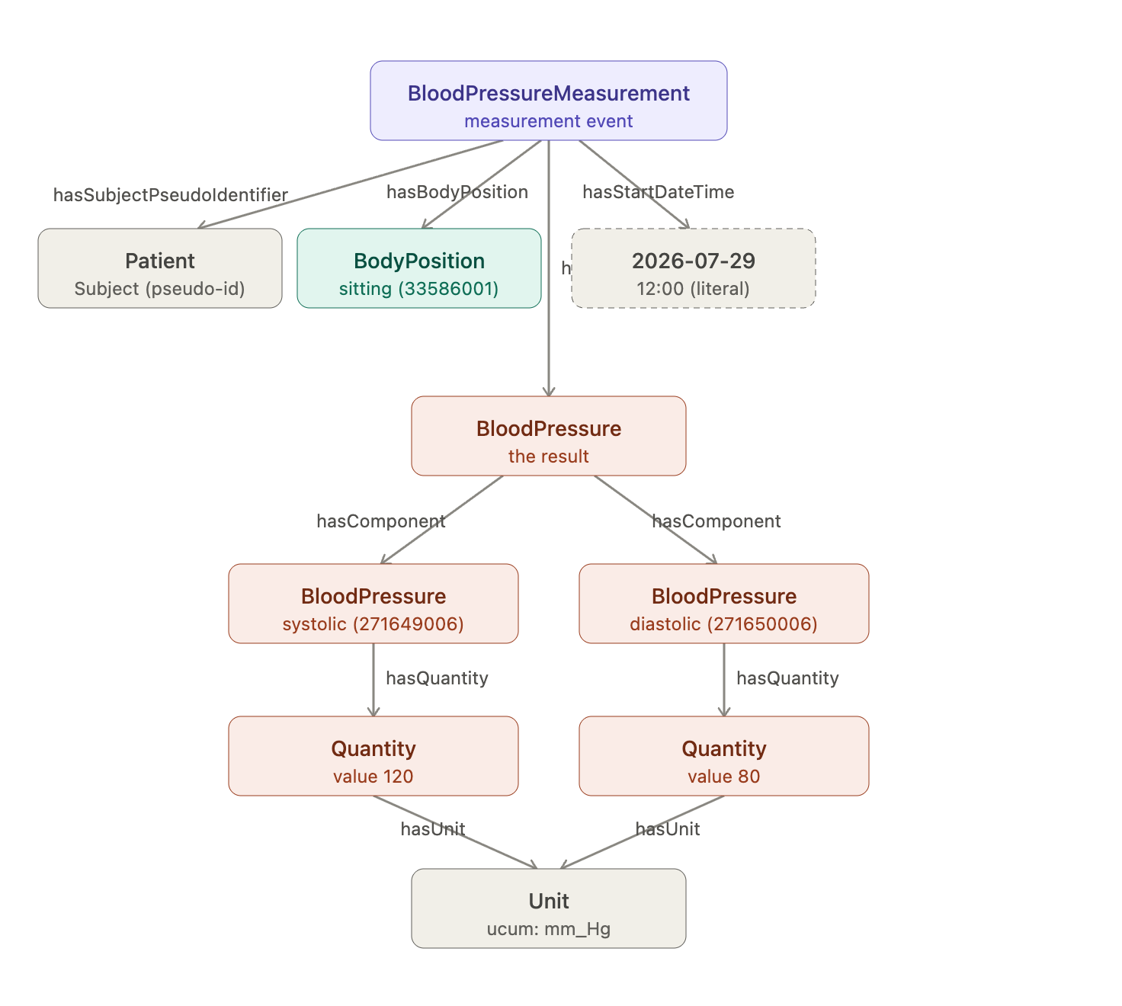
Blood Pressure Example
120/80 mmHg, taken 2026-07-29, patient id 42, during visit 5001
SPHN
KTH / NYU / TU Wien
Andra Ionescu
33
Notes:
Modelling the data

Slide 34
SECOND GENERATION
Information Models
WHY?
!
The information models are diverse, no one size fits all
!
The information models still need mapping to the exchange protocols
• They don’t eliminate mapping, they reduce the load: map once to the standard and then all systems talk with each other
• They predetermine the syntax, structure, semantics – they decide what to NOT map
• They bind to shared terminology systems
KTH / NYU / TU Wien
Andra Ionescu
34

Slide 35
SECOND GENERATION
Data Integration Challenges
THE CHALLENGE
THE SOLUTION
Absence of a stable mediated schema
Common Data Model (CDM) is the attempt to impose a mediated schema (OMOP, PCORnet, Sentinel, etc.)
YES, BUT …
!
No CDM is complete (Garza et al.)
!
Concepts and vocabularies change continuously
!
Semantic loss due to incomplete or incorrect mappings
Lenzerini. 2002 "Data Integration: A Theoretical Perspective”
Doan et al. 2012 “Principles of Data Integration”
Garza et al. 2019 “Evaluating common data models for use with a longitudinal community registry”
KTH / NYU / TU Wien
Andra Ionescu
35

Slide 36
SECOND GENERATION
Data Integration Challenges
THE CHALLENGE
THE DM SOLUTION
Incomplete, institution-specific, poorly maintained mappings
Schema Matching (COMA, Cupid, Similarity Flooding, Valentine, etc.) + Entity Resolution (DeepMatcher, DeepER, Ditto, etc.)
YES, BUT …
!
Automated matchers reduce the manual load, but don’t eliminate it
!
Schema and instances are not enough, semantics matter
Do & Rahm. 2002 (COMA), Madhavan et al. 2001 (Cupid), Melnik et al. 2002 (Similarity Flooding), Koutras et al. 2021 (Valentine)
Mudgal et al. 2018 (DeepMatcher), Ebraheem et al. 2018 (DeepER), Li at al. 2020 (Ditto)
Rahm & Bernstein. 2001 "A survey of approaches to automatic schema matching"
KTH / NYU / TU Wien
Andra Ionescu
36

Slide 37
SECOND GENERATION
Data Integration Challenges
THE CHALLENGE
THE DM SOLUTION
Schema heterogeneity across EHRs — difficulty finding related tables
Dataset discovery methods for finding unionable and joinable tables (Aurum, D3L, Starmie, JOSIE, TUS, PEXESO, DeepJoin, LSH Ensemble, Seeping Semantics, etc.)
YES, BUT …
!
Data access, federated learning: raw patient instances cannot cross institutional boundaries (Abedjan et al.)
!
Privacy preserving discovery: schema level is preferred to prevent data leakage (SMAT)
Fernandez et al. 2018 (Aurum), Bogatu et al. 2020 (D3L), Fang et al. 2023 (Starmie), Zhu et al. 2019 (JOSIE), Nargesian et al. 2018 (TUS), Dong et al. 2021 (PEXESO), Dong at al. 2023 (DeepJoin), Zhu et al. 2016 (LSH Ensamble), Fernandez et al. 2018 (Seeping Semantics), Zhang et al. 2021 (SMAT)
Abedjan et al. 2025 “Data Discovery in Data Lakes: Operations, Indexes, Systems”
KTH / NYU / TU Wien
Andra Ionescu
37

Slide 38
SECOND GENERATION
Terminology Systems
Vocabularies
— finite, curated set of terms with fixed meanings used within a domain: RxNorm (names for clinical drugs, mostly USA), ATC (worldwide)
Terminologies
Classifications
KTH / NYU / TU Wien
Andra Ionescu
38
Notes:
Giving meaning to data
RxNorm is not coded to EHR systems
Compare with ATC code
Highlight the difference at the same level

Slide 39
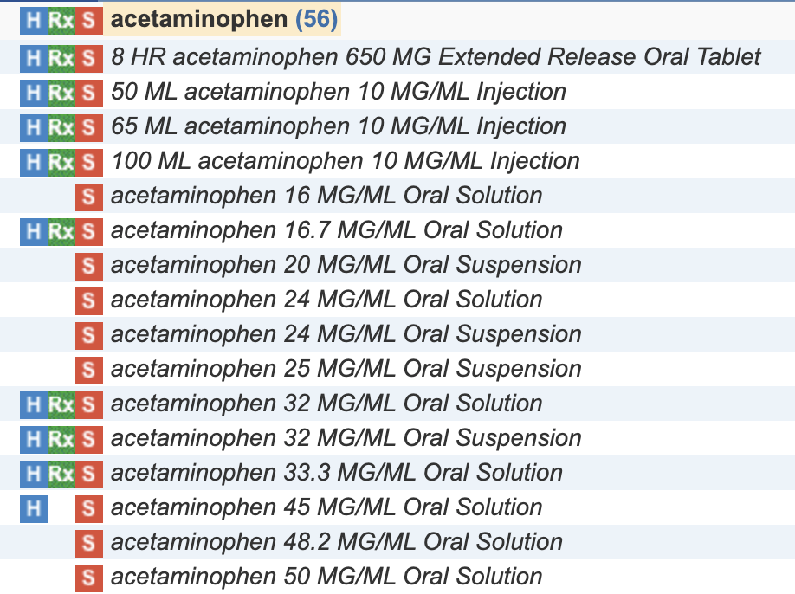
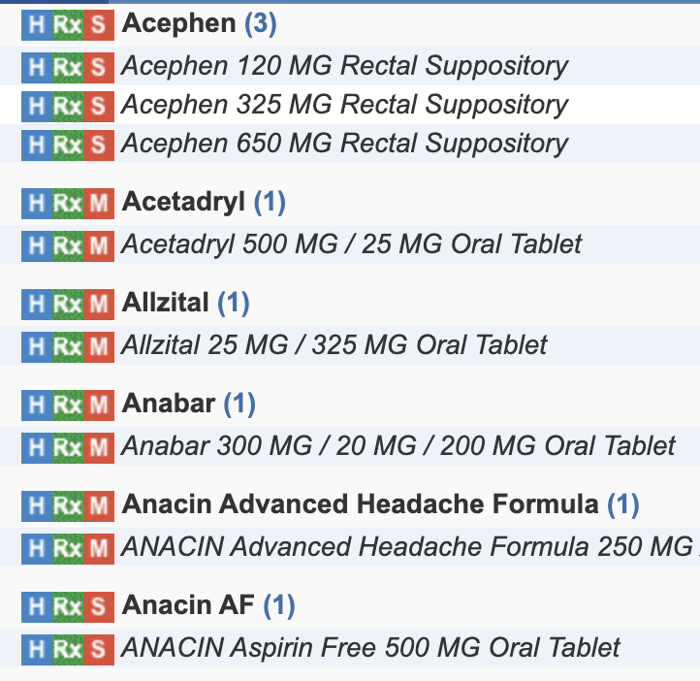
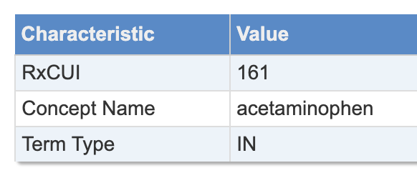
SECOND GENERATION
Terminology Systems
Vocabularies
— finite, curated set of terms with fixed meanings used within a domain: RxNorm (names for clinical drugs, mostly USA), ATC (worldwide)
RxNorm
q: paracetamol
56 results
https://mor.nlm.nih.gov/RxNav/search?searchBy=RXCUI&searchTerm=161
KTH / NYU / TU Wien
Andra Ionescu
39
Notes:
Giving meaning to data
RxNorm is not coded to EHR systems
Compare with ATC code
Highlight the difference at the same level

Slide 40
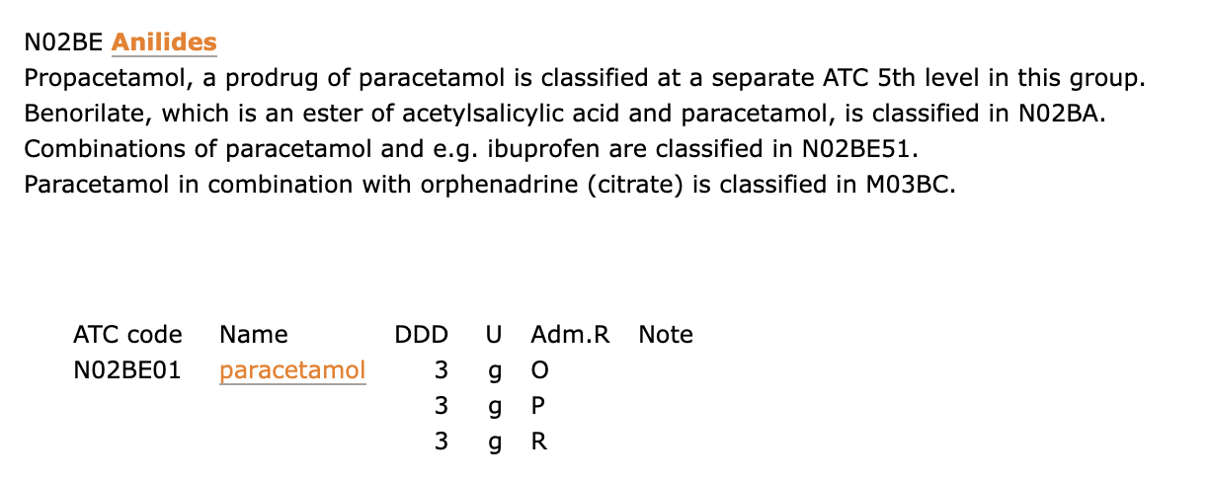
SECOND GENERATION
Terminology Systems
Vocabularies
— finite, curated set of terms with fixed meanings used within a domain: RxNorm (names for clinical drugs, mostly USA), ATC (worldwide)
ATC
q: paracetamol
https://atcddd.fhi.no/atc_ddd_index/?code=N02BE01
KTH / NYU / TU Wien
Andra Ionescu
40
Notes:
Giving meaning to data
RxNorm is not coded to EHR systems
Compare with ATC code
Highlight the difference at the same level

Slide 41
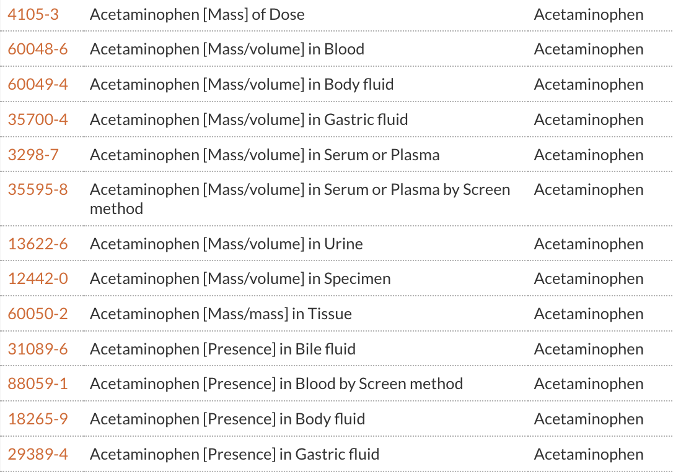
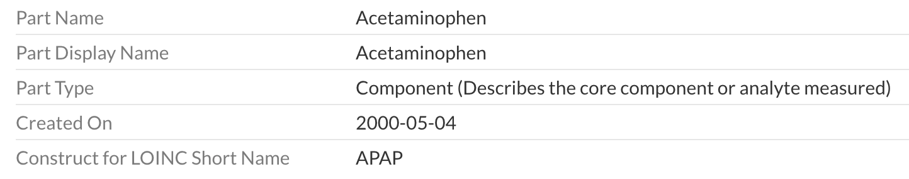
SECOND GENERATION
Terminology Systems
Terminologies
— vocabularies for specialised domains, concept-oriented, captures the relationship between concepts: LOINC (lab tests), SNOMED-CT (findings, disorders, procedures, etc)
LOINC
q: paracetamol
49 results
Code: LP14712-1
https://loinc.org/LP14712-1
https://loinc.org/search?t=1&l=en_US&q=paracetamol+
KTH / NYU / TU Wien
Andra Ionescu
41
Notes:
Show examples
Highlight challenges
Giving meaning to data

Slide 42
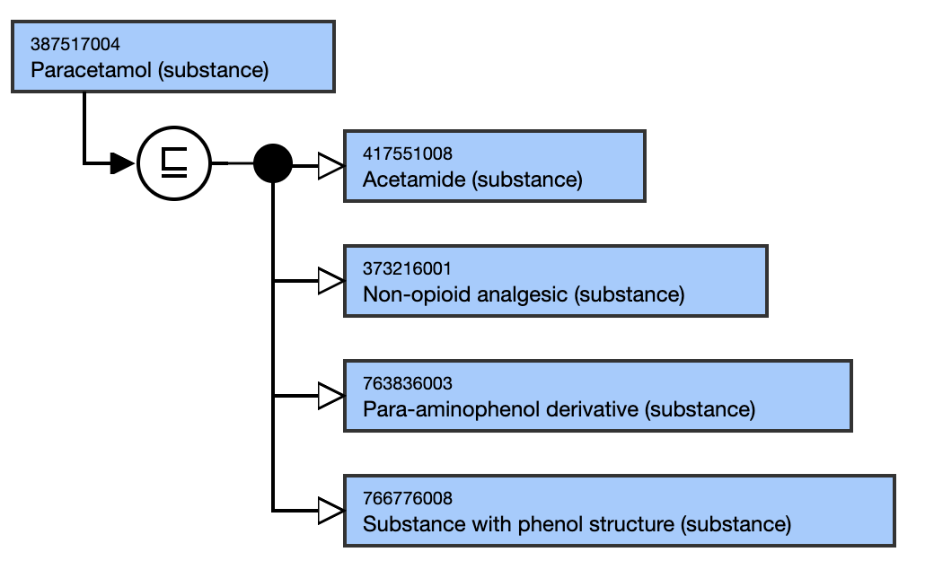
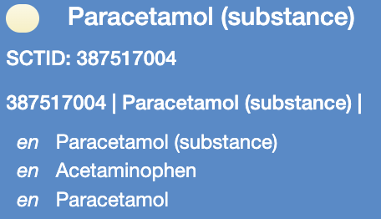
SECOND GENERATION
Terminology Systems
Terminologies
— vocabularies for specialised domains, concept-oriented, captures the relationship between concepts: LOINC (lab tests), SNOMED-CT (findings, disorders, procedures, etc)
SNOMED-CT
q: paracetamol
518 results
https://snomedbrowser.org/?perspective=full&conceptId1=387517004&edition=MAIN/2026-08-01&release=&languages=en
KTH / NYU / TU Wien
Andra Ionescu
42
Notes:
Show examples
Highlight challenges
Giving meaning to data

Slide 43
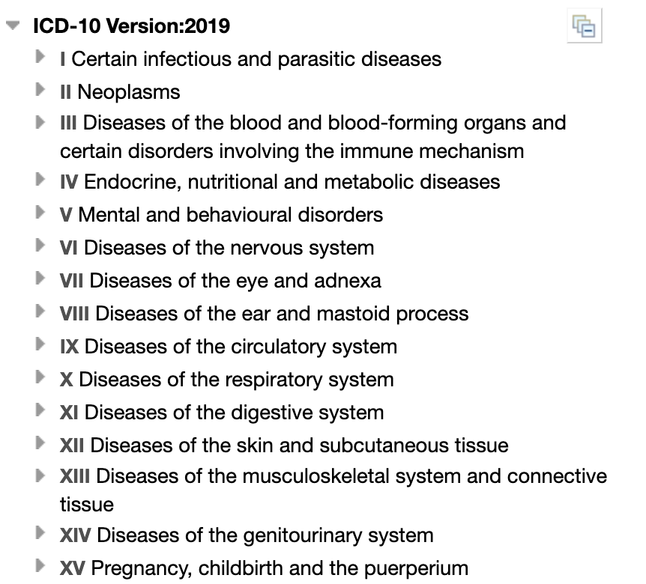
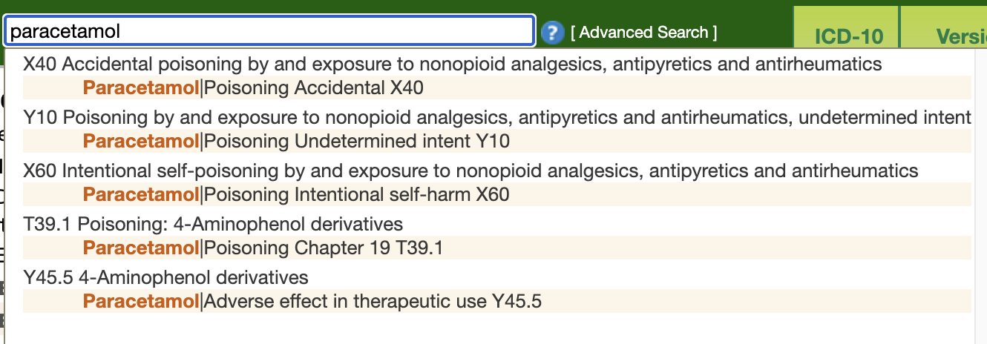
SECOND GENERATION
Terminology Systems
Classifications
— arranges concepts into a set of categories according to explicit criteria: ICD-10 / ICD-11 (diseases)
q: paracetamol
https://icd.who.int/browse10/2019/en#/T39.1
KTH / NYU / TU Wien
Andra Ionescu
43
Notes:
Show examples
Highlight challenges
Giving meaning to data

Slide 44
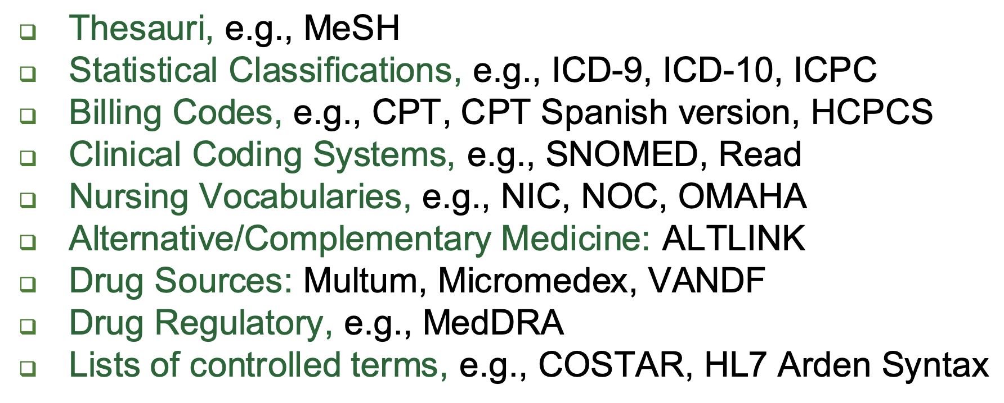
SECOND GENERATION
Terminology Systems
METATHESAURUS
UMLS (Unified Medical Language System) integrates
195
Terminology systems
• links concepts through a shared CUI (Concept Unique Identifier)
• the same concept in RxNorm, SNOMED, MeSH, etc. can resolve to one CUI
Categories of source vocabulary integrated into the UMLS
Dogac, Asuman. "Interoperability in eHealth systems." Proceedings of the VLDB Endowment 5.12 (2012): 2026-2027.
KTH / NYU / TU Wien
Andra Ionescu
44
Notes:
Example with blood pressure in LOINC, SNOMED, openEHR

Slide 45
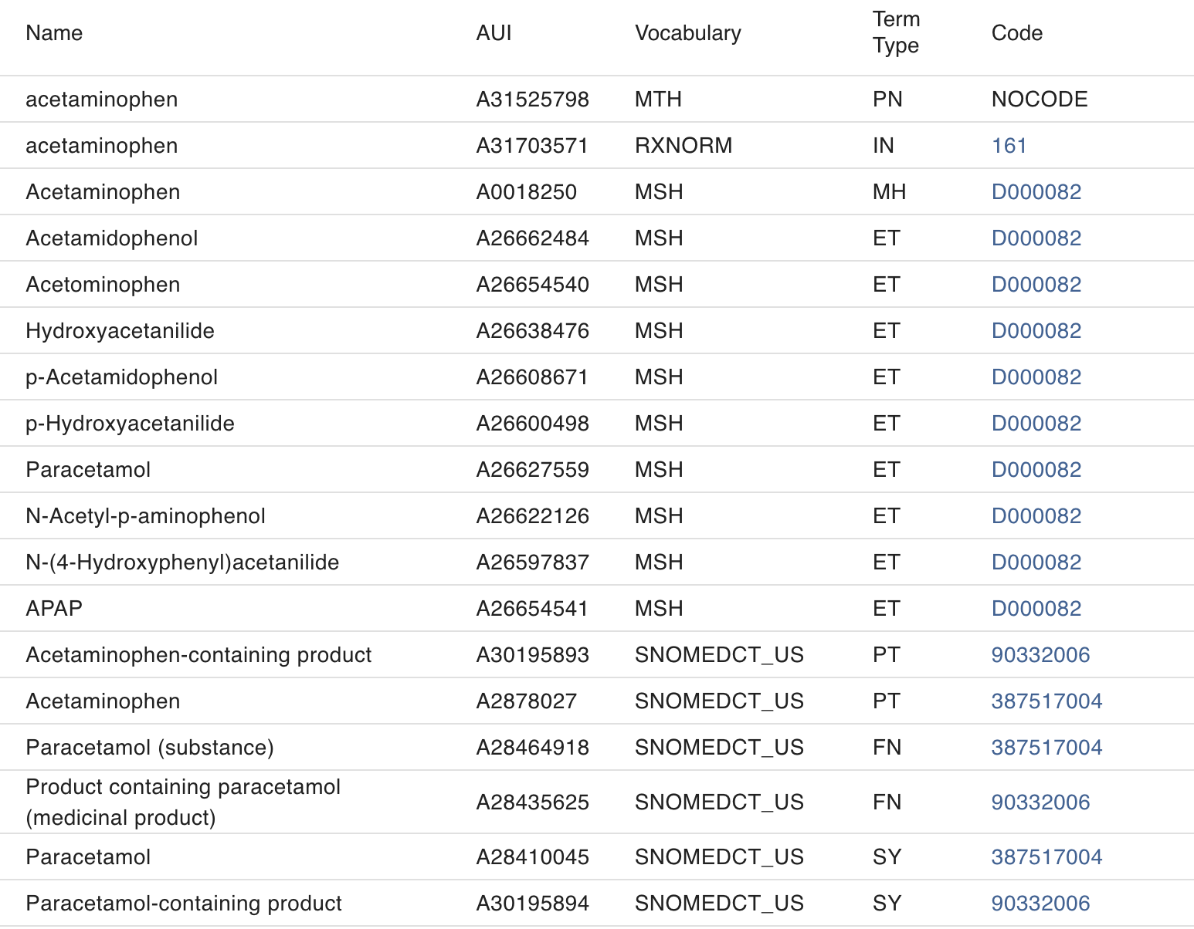
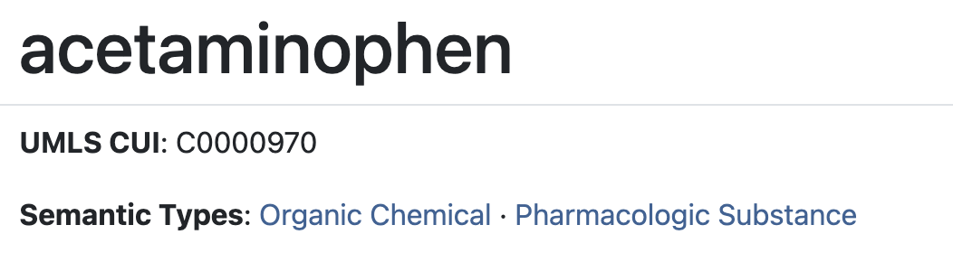
SECOND GENERATION
Terminology Systems
METATHESAURUS
UMLS (Unified Medical Language System) integrates
q: paracetamol
https://uts.nlm.nih.gov/uts/umls/concept/C0000970
KTH / NYU / TU Wien
Andra Ionescu
45
Notes:
Example with blood pressure in LOINC, SNOMED, openEHR

Slide 46
SECOND GENERATION
Data Harmonisation Challenges
Data integration
— providing a unified, queryable view over sources.
Data harmonisation
— mapping local content into a common representation, reconciling representations so values mean the same thing and can be pooled.
THE CHALLENGE
Concept normalisation — mapping a local code/string to a concept in a reference vocabulary (e.g., SNOMED, LOINC)
ALSO KNOWN AS …
KTH / NYU / TU Wien
Andra Ionescu
46

Slide 47
SECOND GENERATION
Data Harmonisation Challenges
Not one step, but a combination of:
Text mention to KG
Cell value to KG
First step: entity extraction
The entity is already “extracted”
Entity Linking / (Named)-Entity Disambiguation
Semantic Table Interpretation / Cell-entity Annotation, SemTab Challenge
YES, BUT …
!
Characterise ambiguity: know when not to map (e.g., cold), KG are not complete
!
Domain specific representations (e.g., abbreviations)
Limaye et al. 2010 (graphical model based), Ritze et al. 2014 (T2K Match), Efthymiou et al. 2017 (Matching Web Tables), Deng et al. 2022 (Turl), Ngyuen et al. 2021 (Mtab), Dong et al. 2023 (BLINKout), Shen et al. 2015 “Entity Linking with a Knowledge Base: Issues, Techniques, and Solutions”, Sevgili et al. 2022 “Neural Entity Linking: A Survey of Models Based on Deep Learning”
KTH / NYU / TU Wien
Andra Ionescu
47

Slide 48
SECOND GENERATION
Ontology Alignment Challenges
So far we assumed a single target — map to SNOMED, ICD, or LOINC. But what about reconciling ontologies directly, e.g., SNOMED to ICD?
THE CHALLENGE
THE SOLUTION
Terminology systems describe the world differently, so alignment is lossy or ambiguous
Ontology mapping and repair tools: LogMap, AgreementMakerLight, BERTMap
YES, BUT …
Foundational mismatch: linking classifications (ICD-10) with vocabularies (SNOMED) requires a shared model of meaning (e.g., BioTop, BFO2), but no one formalism suffices
!
!
Complex correspondences: 1-n, n-m, and subsumption relationships
Jiménez-Ruiz & Cuenca Grau. 2011 (LogMap), Faria et al. 2013 (AgreementMakerLight), He at al. 2022 (BERTMap), Thieblin et al. 2020 “Survey on complex ontology matching”
KTH / NYU / TU Wien
Andra Ionescu
48

Slide 49
SECOND GENERATION
Constructing a 2nd Gen Pipeline
Governing bodies decide the “interoperability stack”
EXAMPLES
MESSAGING
…
EU
HL7 v2
HL7 v3
FHIR
HL7 FHIR + IHE profiles + SNOMED CT, LOINC
EXCHANGE
MAPPING (ETL)
INFORMATION MODELS
…
Proprietary Models
openEHR
OMOP
SPHN
i2b2
USA
BINDINGS?
TERMINOLOGY SYSTEMS
…
HL7 FHIR + CDA + SNOMED CT, RxNORM, LOINC, ICD-10, CVX
SNOMED-CT
LOINC
RxNorm
ICD-10
ICD-11
PROBLEM
!
Many semantic traps: losing the meaning from mapping to mapping
KTH / NYU / TU Wien
Andra Ionescu
49
Notes:
Semantic traps

Slide 50
3
PART 03
Third Generation
Katja Hose, Paris Carbone, Christos Koutras
KTH / NYU / TU Wien
Notes:
The ontologies are already graphs, they should come together, and how we can use the graphs in our advantage
Pitch: standards are a partial solution, graphs don’t solve it entirely, but they are part of the solution
The aim is to simplify the architecture, not radical change (simplify with improving the semantic exchange)

Slide 51
History
KTH / NYU / TU Wien
Speaker’s Name
51

Slide 52
THIRD GENERATION
Integrating Health Data using Graphs
Example Scenario
Two hospitals contribute retrospective cohorts of patients
  No patient appears in both, cannot be linked directly
Heterogeneous representation of data at the hospitals (column names, codes, details , languages, etc.)
Partial overlap of types of information between hospitals
KTH / NYU / TU Wien
Katja Hose
52

Slide 53
THIRD GENERATION
Different Levels of Detail
Example
hospital A hospital B
-------------------------------------------------------------------------------
heart failure prev_heart_failure HFpEF / HFmrEF / HFrEF
antithrombotics prev_antiplatelet, ASA / P2Y12 / AVK / DOAC / ...
prev_anticoagulant
C-reactive protein crp PCR
The two hospitals describe the same clinical concepts at different levels of detail
One boolean (prev_heart_failure) vs. three
Two high-level categories vs. sixteen named drug/drug-level classes, e.g., ASA – Aspirin
Two different abbreviations denoting the same thing
…
KTH / NYU / TU Wien
Katja Hose
53

Slide 54
THIRD GENERATION
Integrating Heterogeneous Patients using Graphs
Hospital A
Condition
No need to design a joint schema or harmonize data upfront
Patient cohorts remain disjoint but become linked via concepts
Examples
  "crp" and "PCR" resolve to the same LOINC code
  SNOMED links two heart-failure codes via a "subclassOf" edge
fhir:code
SNOMED CT
fhir:subject
heart failure
84114007
Patient
A / ID12345
heart failure
fhir:subject
Observation
CRP 41 mg/L
fhir:code
LOINC
1988-5
rdfs:subClassOf
Condition
fhir:code
C-reactive protein
Hospital B
fhir:subject
HFpEF
fhir:code
Patient
B / RO-0088
SNOMED CT
fhir:subject
Observation
703272007
PCR 38 mg/L
HF with preserved ejection fraction
KTH / NYU / TU Wien
Katja Hose
54

Slide 55
THIRD GENERATION
Queries for Retrieving Integrated Data
All patients with heart failure from all hospitals
SELECT ?patient WHERE {
?cond rdf:type fhir:Condition . # find all conditions
?cond fhir:subject ?patient . # find the patients with the identified conditions
?cond fhir:code ?code . # find the code of the identified conditions
?code rdfs:subClassOf* <http://snomed.info/id/84114007> . # restrict to codes that represent
# heart failure, incl. any subtypes
# of it
}
KTH / NYU / TU Wien
Katja Hose
55

Slide 56
THIRD GENERATION
Match the Condition Pattern
Hospital A
Condition
Step 1 of 5
?cond rdf:type fhir:Condition
Find all nodes of type Condition in our graph
fhir:code
SNOMED CT
fhir:subject
heart failure
84114007
Patient
A / ID12345
heart failure
fhir:subject
Observation
CRP 41 mg/L
fhir:code
LOINC
1988-5
rdfs:subClassOf
Condition
fhir:code
C-reactive protein
Hospital B
fhir:subject
HFpEF
fhir:code
Patient
B / RO-0088
SNOMED CT
fhir:subject
Observation
703272007
PCR 38 mg/L
HF with preserved ejection fraction
KTH / NYU / TU Wien
Katja Hose
56

Slide 57
THIRD GENERATION
Retrieve the Codes for the Conditions
Hospital A
Condition
Step 2 of 5
?cond fhir:code ?code
Each condition carries a code
Hospitals use different codes/concepts for heart failures: 84114007 and 703272007
fhir:code
SNOMED CT
fhir:subject
heart failure
84114007
Patient
A / ID12345
heart failure
fhir:subject
Observation
CRP 41 mg/L
fhir:code
LOINC
1988-5
rdfs:subClassOf
Condition
fhir:code
C-reactive protein
Hospital B
fhir:subject
HFpEF
fhir:code
Patient
B / RO-0088
SNOMED CT
fhir:subject
Observation
703272007
PCR 38 mg/L
HF with preserved ejection fraction
KTH / NYU / TU Wien
Katja Hose
57

Slide 58
THIRD GENERATION
Traversing the Hierarchy
Hospital A
Condition
Step 3 of 5
?code rdfs:subClassOf*
sct:84114007
* matches zero hops for 84114007 itself, and one hop for 703272007
This connection comes from SNOMED directly
Both matched concepts are of type heart failure
fhir:code
SNOMED CT
fhir:subject
heart failure
84114007
Patient
A / ID12345
heart failure
fhir:subject
Observation
CRP 41 mg/L
fhir:code
LOINC
1988-5
rdfs:subClassOf
Condition
fhir:code
C-reactive protein
Hospital B
fhir:subject
HFpEF
fhir:code
Patient
B / RO-0088
SNOMED CT
fhir:subject
Observation
703272007
PCR 38 mg/L
HF with preserved ejection fraction
KTH / NYU / TU Wien
Katja Hose
58

Slide 59
THIRD GENERATION
Retrieving Patients with those Conditions
Hospital A
Condition
Step 4 of 5
?cond fhir:subject ?patient
We have two patients linked to these conditions
fhir:code
SNOMED CT
fhir:subject
heart failure
84114007
Patient
A / ID12345
heart failure
fhir:subject
Observation
CRP 41 mg/L
fhir:code
LOINC
1988-5
rdfs:subClassOf
Condition
fhir:code
C-reactive protein
Hospital B
fhir:subject
HFpEF
fhir:code
Patient
B / RO-0088
SNOMED CT
fhir:subject
Observation
703272007
PCR 38 mg/L
HF with preserved ejection fraction
KTH / NYU / TU Wien
Katja Hose
59

Slide 60
THIRD GENERATION
The Result
Hospital A
Condition
Step 5 of 5
SELECT ?patient
Output the nodes of the patients suffering from heart conditions
Adding more patients only requires connecting them to standardized conditions
fhir:code
SNOMED CT
fhir:subject
heart failure
84114007
Patient
A / ID12345
heart failure
fhir:subject
Observation
CRP 41 mg/L
fhir:code
LOINC
1988-5
rdfs:subClassOf
Condition
fhir:code
C-reactive protein
Hospital B
fhir:subject
HFpEF
fhir:code
Patient
B / RO-0088
SNOMED CT
fhir:subject
Observation
703272007
PCR 38 mg/L
HF with preserved ejection fraction
KTH / NYU / TU Wien
Katja Hose
60

Slide 61
THIRD GENERATION
Actual Query is Slightly More Complicated
FHIR is more verbose and complex, so the actual FHIR-based query looks like this
SELECT ?patient WHERE {
?cond rdf:type fhir:Condition . # find all conditions
?cond fhir:subject/fhir:link ?patient . # the patient URI (ID) is nested inside another object
?cond fhir:code/fhir:coding/fhir:code/fhir:v ?code . # the code is nested even deeper
BIND( IRI(CONCAT("http://snomed.info/id/", ?code)) AS ?concept ) # the code is an
# integer or alphanumeric value,
# so we use BIND to transform it
# into a URI (URL)
?concept rdfs:subClassOf* <http://snomed.info/id/84114007> . # restrict to codes that represent
# heart failure, incl. any subtypes
# of it}
KTH / NYU / TU Wien
Katja Hose
61

Slide 62
THIRD GENERATION
Graph-Based Integration
Extensible to further hospitals with different representations
External standards and resources for linking related concepts (LOINC, SNOMED, etc.)
Ontologies can be integrated flexibly
Flexible with respect to updates
…
Challenges
Mapping local codes to external standards
Example: "crp" and "pcr" to "1988-5“ (LOINC)
More computational load when retrieving the data
…
KTH / NYU / TU Wien
Katja Hose
62

Slide 63
THIRD GENERATION
Integration using LLMs: A Case Study
Denmark has a centralized national hospital register since the 70s (The Danish National Patient Register)
Evolving registries (three major revisions so far)
CPR
Det Centrale Personregister
t_person
t_person_status
t_adresse_udland
+2 history
LPR1 / LPR2
Landspatientregisteret, 1977–
t_adm
t_diag
t_sksube
+3 more
LPR2 psyk.
psychiatric extension, 1995–
t_psyk_adm
t_psyk_diag
t_psyk_sksopr
+4 more
LPR3
rebuilt 2019, SOR-based
kontakter
diagnoser
procedurer_kirurgi
+2 more
DAR
Dødsårsagsregisteret
t_dodsaarsag_1
t_dodsaarsag_2
LSR
Lægemiddelstatistikregisteret
epikur
laegemiddel
+1 more
SMR
Sygehusmedicinregisteret, 2018–
indberetningmedpris
LAB
Laboratoriedatabasen
lab_dm_forsker
lab_dm_labidcodes
+1 more
SOR
Sundhedsvæsenets Organisationsregister
organisationer
SOREntity
shakcomplete
Example:
SKS KTPJ05E
“Nålebiopsi af ingvinal
lymfeknude” · 2,860 rows
→ SNOMED 4120431
Registries CPR Central Personal Registry · LPR National Patient Register · DAR Cause of Death Register · LSR Medicines Statistics Register · SMR Hospital Medicine Register · LAB Laboratory Database · SOR Healthcare Organization Register
Code systems ICD International Classification of Diseases (-DK = Danish edition) · SKS Danish Healthcare Classification System · NPU Nomenclature for Properties and Units · ATC Anatomical Therapeutic Chemical · VNR Varenummer (product number) · SHAK Hospital Department Classification
KTH / NYU / TU Wien
Katja Hose
63

Slide 64
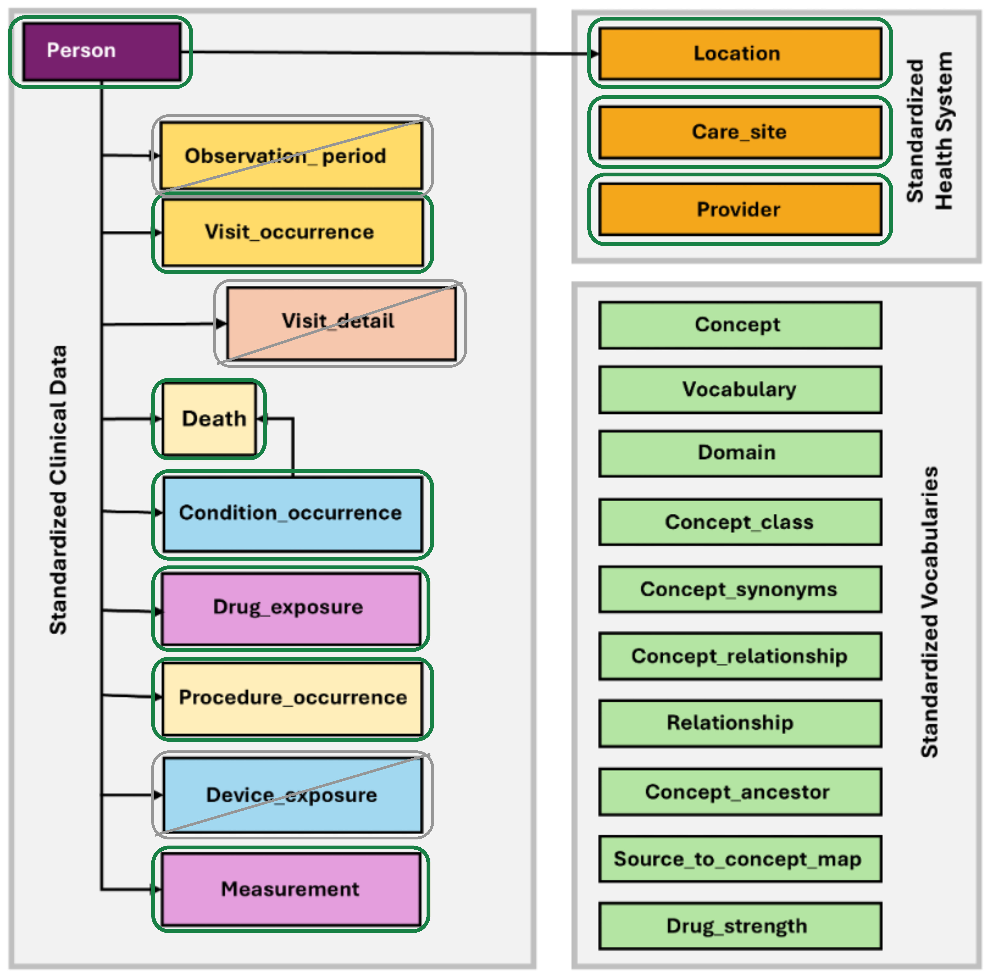
THIRD GENERATION
Joint Analysis Requires Integration
Mapping to OMOP
OMOP table | From registries | Records
person | CPR | 4.89 M
death | DAR + CPR | 1.81 M
visit_occurrence | t_adm + kontakter | 108.8 M
condition_occurrence | t_diag | 251.5 M
procedure_occurrence | SKS + LPR3 | 34.6 M
drug_exposure | epikur + SMR | 1,095 M
measurement | lab_dm_forsker | 1,672 M
care_site + provider | SOR, SHAK, LAB | 155 k
location | geo files | 1 k
3.8 billion source records, 11 national registries, 9.1 million patients
KTH / NYU / TU Wien
Katja Hose
64

Slide 65
THIRD GENERATION
Four Ways to Map Codes and Concepts
Which method is applicable depends on the concrete issue
Crosswalk
use when
the mapping already exists
ICD-10-DK, ATC, VNR
130,167 rows loaded as a dictionary
Mapping Tool (Usagi)
use when
English terms, ranked suggestions
SKS, NPU
1,242 procedure mappings after expert review
Keyword rules
use when
naming is consistent
care sites: “apotek”, “tandpleje”
37,028 of 150,191 sites (24.7%)
LLM
use when
Danish free text, no pattern, too big to map by hand
the remaining care sites
113,163 sites, $65.82
what we achieved
89.3% of 312.7 M condition rows
121,834 ICD-10-DK codes
99.93% of 1.34 B drug rows
what we achieved
93.35% of procedures
32.3 M of 34.6 M rows
99.24% of 1.59 B lab rows
what we achieved
37,028 of 150,191 sites
4,191 SOR codes inspected
113,163 left over
what we achieved
113,163 sites classified
77% accuracy, $65.82 total
ATC — Anatomical Therapeutic Chemical Classification Code
VNR — Varenummer — product/article number
SKS — Sundhedsvæsenets Klassifikationssystem — Clinical and Administrative Information
NPU — Nomenclature for Properties and Units
SOR — Sundhedsvæsenets Organisationsregister — Danish Healthcare Organization Register
KTH / NYU / TU Wien
Katja Hose
65

Slide 66
THIRD GENERATION
Four Ways to Map Codes and Concepts
Which method is applicable depends on the concrete issue
Crosswalk
use when
the mapping already exists
ICD-10-DK, ATC, VNR
130,167 rows loaded as a dictionary
Mapping Tool (Usagi)
use when
English terms, ranked suggestions
SKS, NPU
1,242 procedure mappings after expert review
Keyword rules
use when
naming is consistent
care sites: “apotek”, “tandpleje”
37,028 of 150,191 sites (24.7%)
LLM
use when
Danish free text, no pattern, too big to map by hand
the remaining care sites
113,163 sites, $65.82
what we achieved
89.3% of 312.7 M condition rows
121,834 ICD-10-DK codes
99.93% of 1.34 B drug rows
what we achieved
93.35% of procedures
32.3 M of 34.6 M rows
99.24% of 1.59 B lab rows
what we achieved
37,028 of 150,191 sites
4,191 SOR codes inspected
113,163 left over
what we achieved
113,163 sites classified
77% accuracy, $65.82 total
ATC — Anatomical Therapeutic Chemical Classification Code
VNR — Varenummer — product/article number
SKS — Sundhedsvæsenets Klassifikationssystem — Clinical and Administrative Information
NPU — Nomenclature for Properties and Units
SOR — Sundhedsvæsenets Organisationsregister — Danish Healthcare Organization Register
KTH / NYU / TU Wien
Katja Hose
66

Slide 67
THIRD GENERATION
Example Classification using LLMs
150,191
SOR organizations from the register
37,028
keyword rules and human review first
113,163
left for the LLM
Example prompt
You are a medical administrator. Classify each medical organization into the most appropriate standard category, selecting the most specific type when more than one may apply.
Example Mappings
Nordhavn Apotek, filial af Farum Apotek → Pharmacy
OUH Neurokirurgisk Afsnit U → Inpatient Hospital
L. Tronegård & M. S. Schmidt → Ambulatory Primary Care Clinic
Hudlægeklinikken Frederikshavn → Ambulatory Medical Specialty Clinic
Psykologhuset Svenstrup → Ambulatory Adult Mental Health Clinic
SOR - Sundhedsvæsenets Organisationsregister - Danish Healthcare Organization Register
KTH / NYU / TU Wien
Katja Hose
67

Slide 68
THIRD GENERATION
Example
A clinic recorded under a doctor's name
clinic record
Name: Michael Skjelbo Nielsen
Type: supplerende oplysninger
Part of: Hjerteklinik Nordjylland I/S
Inst. type: speciallægepraksis
Speciality: intern medicin
what came back
Ambulatory Medical
Specialty Clinic / Center
concept_id 38004240
and its reason
“part of a speciallægepraksis with a specialty in intern medicin, which indicates outpatient specialty care without inpatient services”
The name was not helpful, so the LLM used the other fields
The fourth field contained the important information: speciallægepraksis → Ambulatory Medical Specialty Clinic
The LLM also provides a reason for final human review
KTH / NYU / TU Wien
Katja Hose
68

Slide 69
3
PART 03
Interoperability through Link Prediction,
and Statistical Trust
Paris Carbone
KTH / NYU / TU Wien
Notes:
The ontologies are already graphs, they should come together, and how we can use the graphs in our advantage
Pitch: standards are a partial solution, graphs don’t solve it entirely, but they are part of the solution
The aim is to simplify the architecture, not radical change (simplify with improving the semantic exchange)

Slide 70
THIRD GENERATION
The Problem
Quiz: How many interoperability conflicts do you see ?
Equipment Makers
Insurers & Payers
Hospital management
Regional Authorities
EU & National Legislators
Individual Clinicians
KTH / NYU / TU Wien
Paris Carbone

Slide 71
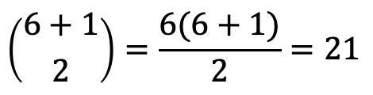
THIRD GENERATION
The Problem
Quiz: How many interoperability conflicts do you see ?
Equipment Makers
Insurers & Payers
$$\left({6+1 \atop 2}\right)=\frac{6(6+1)}{2}=21$$
Hospital management
Regional Authorities
EU & National Legislators
Individual Clinicians
KTH / NYU / TU Wien
Paris Carbone

Slide 72
THIRD GENERATION
The Problem
A fragmentation issue
HL7, SNOMED CT, LOINC, ICD each solved their own layer, on their own timeline, at a technical level
ICD (International Classification of Diseases) has met the most success…as a cash register (billing, insurance)
organizational interoperability remains elusive because hospitals adopting the same standards still produce semantically incompatible datasets (as noted by Healthcare Information and Management Systems Society - HIMSS)
KTH / NYU / TU Wien
Paris Carbone
Notes:
The point is not that the standards failed technically — they worked. The point is that they were built by different committees, for different constituencies, on different timelines.
ICD is a cash register. It is the vocabulary insurers reimburse against, so it was optimised for billing, not for describing what the clinician saw.
same standards, incompatible datasets.

Slide 73
THIRD GENERATION
Example
Can one standard save the day?
HOSPITAL A
HOSPITAL B
1 row
[start date, end date],
spanning three days
3 rows
one per day,
same clinical event
blood-pressure episode
inflammation marker
called CRP
called PCR
PCR stands for polymerase chain reaction, while in Spanish, PCR is C-reactive protein.
!
We can agree on the envelop (e.g., HL7). We need to be able to map the contents
KTH / NYU / TU Wien
Paris Carbone
Notes:
The blood-pressure one is about EVENT MODELLING: is an episode one fact with a duration, or a series of daily facts? No standard answers that.
The CRP/PCR one is about NAMING, and it is worse than it looks. PCR is also polymerase chain reaction — a completely different test — and in Spanish-language sites PCR is the normal abbreviation for C-reactive protein. So the same three letters mean two different things depending on the language of the site. A string matcher will happily align them.
HL7 delivers the envelope; nothing checks the contents.

Slide 74
THIRD GENERATION
The Shift
From Transformation to Inference
GEN 2
GEN 3
Map every source into one rigid schema
Decouple representation from any schema
What does not fit is dropped
Align subgraphs, not isolated attributes
The loss is structural
Infer the missing links between concepts
de Mello 2022 · Abad-Navarro 2024 · Zhou et al. 2022 (cross-institutional EHR KG integration) · FHIR Lens, CBMS 2025 · CogKR · BioHopR, ACL 2025 · Cappuzzo, EDBT 2024
KTH / NYU / TU Wien
Paris Carbone
Notes:
Gen 2's failure is not that people were careless — it is that a schema is a decision, made in advance, about what may be represented. Anything outside it cannot be stored, so the loss is structural.
Gen 3's answer, a standard-agnostic semantic layer. The graph is the layer that no single standard has to win. Alignment happens over subgraphs and interconnected concepts rather than isolated attributes.
we stop transforming records and start inferring links.

Slide 75
THIRD GENERATION
Tasks
“Mapping” comes in flavors
EQUIVALENCE · A ≡ B
SUBSUMPTION · A ⊑ B
NORMALISATION text → concept
These two mean the same thing
This is a kind of that
Attach free-text to a standard concept
NCIT Gastric Carcinoma
≡ DOID stomach cancer
KTPJ05E ⊑ SNOMED lymph node biopsy
DE119 → SNOMED 201826
Most researched
More common, less researched.
The entry point for real EHR data.
All three mappings can be modeled as a link prediction problem in a graph.
 | Candidate Pairs
NCIT–DOID | 133 million
SNOMED–FMA (body) | 3.1 billion
SNOMED × FMA | 37 billion
SNOMED × NCIT | 50 billion
KTH / NYU / TU Wien
Paris Carbone
Notes:
The reason to separate them: when someone says 'ontology matching is at 0.9 F1', they mean equivalence. Subsumption — the relation you actually get when a local code is more specific than any standard concept — is scored by ranking only, sits far lower, and has had essentially one genuine participant in the benchmark's history.
Concept normalisation is where real EHR data enters: a free-text string or a local code, not a well-formed ontology class.

Slide 76
THIRD GENERATION
Methods
the 3 mapping steps and methods
CANDIDATE GENERATION
VERIFICATION
GLOBAL FILTER
cheap, high recall
narrow millions of pairs to hundreds
›
expensive, high precision
score each surviving pair
›
cardinality, threshold, coherence
turn scores into an alignment
Lexical
AgreementMakerLight, LogMapLt
candidate generation
Logic + repair
LogMap, LogMapBio
global filter, the only family with a coherence check
Language models
BERTMap, BERTSubs, SapBERT
verification
Ontology / graph embeddings
OWL2Vec*, OWL2Vec4OA, BioGITOM
generation + verification
KG entity alignment
GCN-Align, BootEA, RDGCN
verification
LLM-based
OLaLa, LLMs4OM, Agent-OM, LogMap-LLM
verification
Hybrid / ensemble
Matcha, HybridOM
all three
KTH / NYU / TU Wien
Paris Carbone
Notes:
~2:00, and this is the most pedagogic slide in Part II.
Teach the pipeline first, left to right. Every system — a 2001 string matcher, a 2025 LLM agent — has these three stages. Generation is cheap and must not lose the right answer. Verification is expensive and is where the model sits. The global filter turns a pile of scores into an actual alignment.
logic + repair is the one family that puts anything in the third box beyond a threshold; and the LLM family is a verification technique, not a new paradigm.
If you are short on time, this slide survives on the three boxes alone.

Slide 77
KTH / NYU / TU Wien
“
When a measure becomes a target, it ceases to be a good measure
Charles Goodhart's Law

Slide 78
THIRD GENERATION
Evaluation
Let’s talk about Efficacy
Ontology Alignment Evaluation Initiative’s Bio-ML benchmark : The “TPC” of medical interoperability since 2022
① GLOBAL MATCHING
② LOCAL RANKING
Output a complete alignment → P / R / F1
Rank the truth against 100 negatives → MRR, Hits@1
“Can you produce an alignment someone could actually use?”
“Can you tell the right answer from a hundred wrong ones?”
The reference mappings are known to be incomplete. Under global matching, a system that proposes a correct mapping that is missing from the gold standard is punished as a false positive. Fixing the candidate set removes that penalty.
Focuses on matching whole biomedical ontologies
OMIM – ORDO
NCIT – DOID
SNOMED – FMA
SNOMED – NCIT
SNOMED – NCIT
disease
disease
body
pharm
neoplasm
Equivalence and subsumption · unsupervised and semi-supervised · references derived from Mondo and from UMLS concept identifiers
KTH / NYU / TU Wien
Paris Carbone
Notes:
"So we have a lot of systems. How do we know whether any of them work?
There's a standing benchmark — OAEI Bio-ML. Five pairs of biomedical vocabularies, where the correct mappings are known, taken from Mondo and from UMLS.”
(point left)
"The first way is global matching. Give me your complete alignment — every mapping you're willing to commit to. I compare it against the gold standard and I compute precision, recall, F1.
(point right)
The second way is local ranking. I take one mapping I know is correct. I hide the right answer among a hundred wrong ones, and I ask you to rank them. Did the right one come first? That's Hits@1. How high was it on average? That's MRR.”
"Why would you need two?
Because nobody has ever written down every correct mapping between SNOMED and NCIT. The gold standard is incomplete, and everyone knows it.
So under global matching, if your system finds a correct mapping that the curators simply never got to — you're penalised. It counts as a false positive. You're punished for being right.
Local ranking avoids that entirely, because the candidate set is fixed. The right answer is guaranteed to be in the list, so there's nothing to be unfairly punished for.”
Local ranking is a multiple-choice exam. A hundred and one options, and the right answer is definitely one of them.
Global matching is an open exam. Nobody gives you the options. And you also have to decide how many answers to give — where to stop.
Why a hundred negatives? They're sampled to be hard — lexically similar concepts and structurally nearby ones, not random ones. And the sampler guarantees it never accidentally inserts a true mapping as a "wrong" answer.
btw F1 is the harmonic mean of precision ℗ and Recall ®
Why no F1 for subsumption? Because you can't enumerate every correct superclass — disorder, disease, clinical finding are all technically right. You can't compute recall against a set nobody can write down. So subsumption is ranking-only.

Slide 79
THIRD GENERATION
Results
Ranking is solved. Alignment not yet
0.89 – 0.97
0.72 – 0.92
0.33 – 0.70
best MRR, local ranking
every task, every year
best F1, global matching
across the five pairs
best Hits@1, subsumption
ranking
essentially saturated
and flat since 2023
one genuine entrant, ever
Contesters differ each year
2023
2024
2025
OMIM – ORDO
0.715
0.715
0.715
NCIT – DOID
0.913
0.918
0.908
SNOMED – FMA
0.790
0.790
0.790
SNOMED – NCIT (pharm)
0.790
0.902
0.760
SNOMED – NCIT (neoplasm)
0.771
0.771
0.782
LogMapBio, logic-based, 2011 is still the best unsupervised result on two of the five pairs in 2025.
OAEI Bio-ML results, 2023–2025 (CEUR-WS).
KTH / NYU / TU Wien
Paris Carbone
Notes:
~2:00. The payoff of Part II. Three numbers, then the table, then the callout.
Left: the multiple-choice exam — 101 candidates, right answer guaranteed present. Systems get it almost every time. Middle: the open exam — produce an alignment someone can use. Same systems, much lower. Right: subsumption, and note it is Hits@1, not F1, because no F1 exists for that task.
THE TABLE. Five pairs, three editions. Three of them have not moved at all. One (pharm) jumped in 2024 and fell back in 2025. One gained a point.
part of that flatness is organiser-maintained baselines being re-published unchanged rather than three years of failed attempts. So the honest claim is the ABSENCE OF A TREND, not a measured decline.
LogMapBio is LogMap plus biomedical background knowledge — not LogMapLt, which is the string-only baseline you meet on the next slide. A 2011 system still leads unsupervised on two of five pairs.
CLOSING LINE: 'Scoring a candidate pair is not the open problem. Deciding what to commit is.'

Slide 80
THIRD GENERATION
Diagnosis
Where the Difficulty Actually Lives
A RECALL PROBLEM
A THRESHOLDING PROBLEM
THE EASY ONE
OMIM – ORDO
SNOMED – NCIT (neoplasm)
NCIT – DOID
LogMapLt: P = 0.94, R = 0.25. Even the best system reaches only R = 0.61.
BERTMap P = 0.56 / R = 0.76. LogMapLt P = 0.95 / R = 0.52. Opposite operating points, near-identical F1.
Best F1 above 0.90, and subsumption is near-solved here too.
Gene- and phenotype-style names share almost no surface form with Orphanet labels.
Compositional terms
site + morphology + behaviour.
Two disease ontologies with heavily overlapping English labels.
Only the first is a problem of representation. The second is a problem of deciding where to cut.
Two systems can agree on every score and still disagree completely about which mappings to commit.
!
KTH / NYU / TU Wien
Paris Carbone
Notes:
~1:30. This slide converts the previous one's aggregate numbers into mechanism.
OMIM–ORDO: the systems are precise and blind. They find a clean subset and miss the rest, because the naming conventions do not overlap. That is a representation and coverage problem — better encoders would genuinely help.
Neoplasms: the systems are not blind, they are undecided. BERTMap and LogMapLt sit at near-opposite operating points and land at the same F1. Nothing about a better encoder fixes that — it is a threshold question.
The callout is the bridge into Part III. Say it slowly.

Slide 81
THIRD GENERATION
Evidence
Does the Structure Earn Its Place?
ABLATIONS
RE-EVALUATIONS, FROM OUR OWN COMMUNITY
BERTMap · AAAI 2022, SNOMED–FMA
OpenEA · PVLDB 2020
Prediction only 0.832 → + structure 0.832 → + repair 0.836. The text-corpus ablation moves F1 from 0.350 to 0.832.
Embedding-based entity alignment showed “no superiority over the conventional approaches PARIS and LogMap”.
LogMap-ML · ESWC 2021
Leone et al. · PVLDB 2022
Adding path context made it worse: 0.885 with paths against 0.927 without.
Non-neural PARIS+ significantly outperforms all representative neural methods; ~80% of the gap is entities matchable by simple string matching.
LLMs4OM · ESWC 2024
OM as link prediction · OM 2025
Parent/child context helped in some domains and degraded performance on the Bio-ML tasks.
17 KGE models over the merged ontologies: 74.9% F1 on a structure-rich, label-poor task, but 31.8% vs BERTMap's 64.6% on OMIM–ORDO.
Structure earns its place in domains that are structure-rich and label-poor.
Biomedical vocabularies are label-rich. Which makes structural methods struggle to justify themselves here.
KTH / NYU / TU Wien
Paris Carbone
Notes:
BERTMap's own authors measured it: structure and repair together are worth four thousandths of F1; the text corpus is worth almost half a point. Two other papers found structural context actively hurting on biomedical tasks.
The two PVLDB papers matter most for this room because they are ours, and they are negative results about neural methods that our own community published.
Bottom line: structure is not useless, it is conditional. It pays in label-poor domains. Biomedical ontologies are the opposite of that.

Slide 82
THIRD GENERATION
Risk
What If the Wrong Line Is Drawn?
The failure is silent, the shortcut is invisible, and both move when the data moves
The model may be learning the wrong regularity
In biomedical knowledge-graph completion, accuracy tracks how well-connected a node is. Well-connected concepts match well-connected concepts whether or not they mean the same thing.
WHAT WE ACTUALLY WANT
“I am not sure about this one.
Can you take a look?”
And it moves when you move site
A system that knows which of its own outputs to escalate based on the uncertainty.
Coding practice, episode structure and graph topology all differ across hospitals. A system tuned on one site is not tuned on the next.
!
The system already produces a confidence score. It just isn't a probability.
A 0.9 does not mean a nine-in-ten chance of being right and nobody knows what it does mean.
KTH / NYU / TU Wien
Paris Carbone
Notes:
~1:30. Opens Part III. Keep it concrete and calm.
Three risks. The silent one is the important one: in the second generation a failed mapping left concept_id = 0 and you could count them. Now it leaves a plausible code.
The shortcut risk: models can be right for reasons that do not transfer. Degree correlation in biomedical KG completion is the documented case.
And distribution shift is not hypothetical here — it is the entire premise of the tutorial. Every hospital is a different distribution.
The right-hand quote is the human ask, in plain words. Then the callout sets up the next slide: the model has a confidence number; it just does not mean anything.

Slide 83
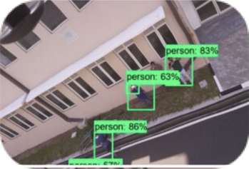
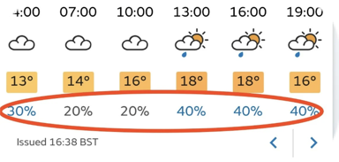
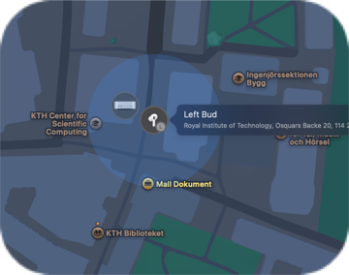
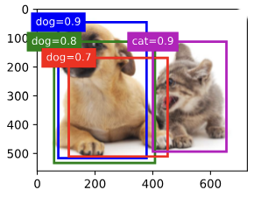
THIRD GENERATION
Risk
Uncertainty for decision processes
KTH / NYU / TU Wien
Paris Carbone

Slide 84
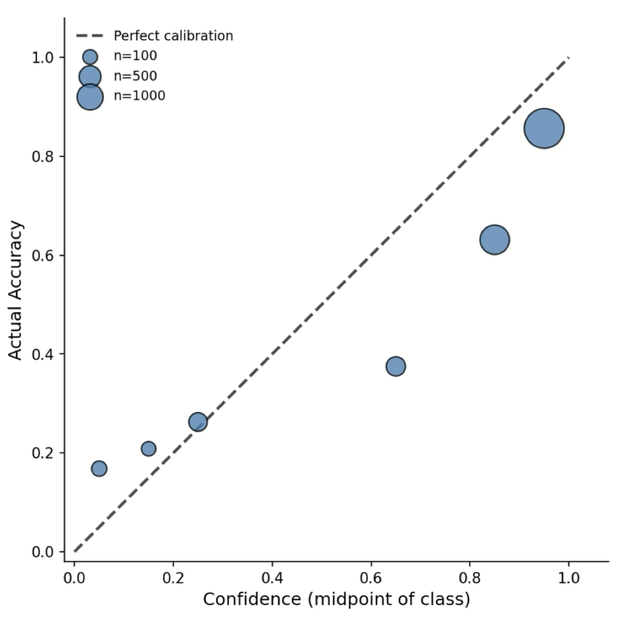
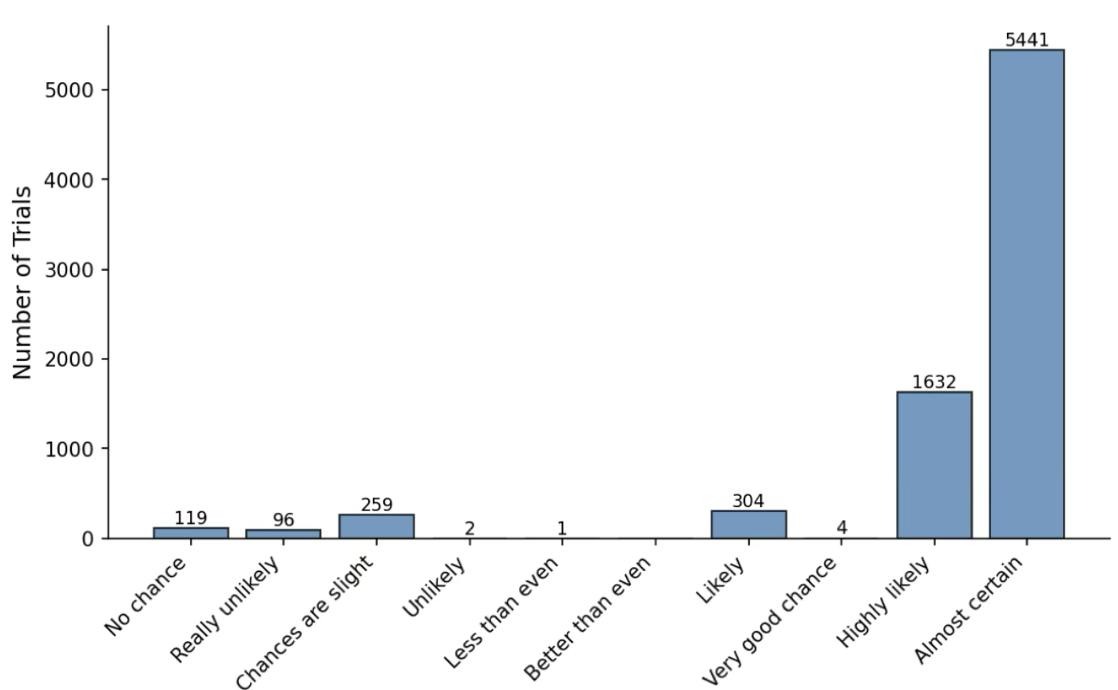
THIRD GENERATION
Risk
Asking our models to give us confidence
Overconfident zone
How do LLMs Compute Verbal Confidence? - Kumaran et al @Deepmind arXiv March 2026
KTH / NYU / TU Wien
Paris Carbone

Slide 85
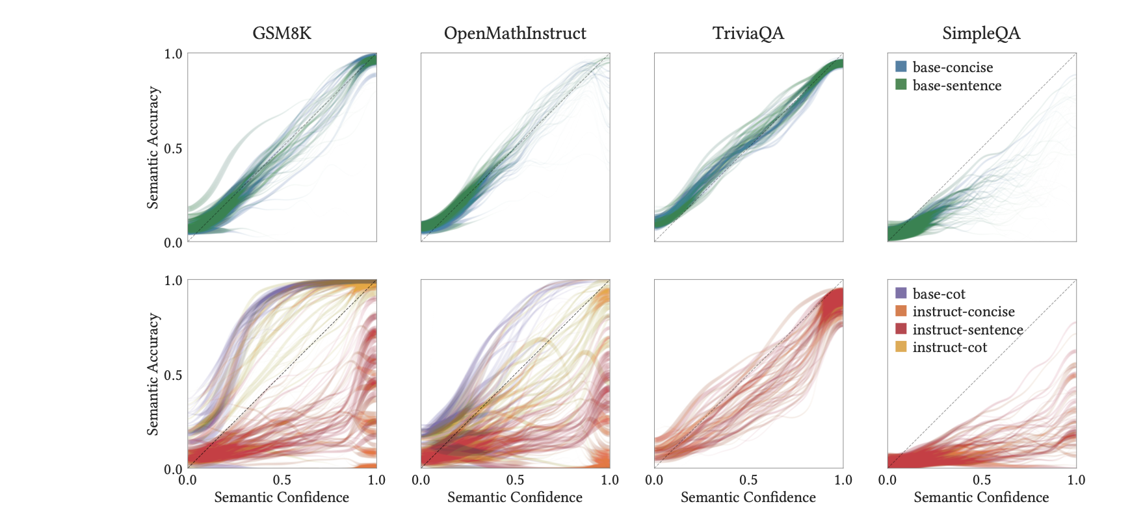
THIRD GENERATION
Risk
Where calibration breaks
Error grows with capabilities (chain of thought, reasoning RL)
Trained on Tokens, Calibrated on Concepts: The Emergence of Semantic Calibration in LLMs - Nakkiran et al @Apple arXiv Nov 6 2025
KTH / NYU / TU Wien
Paris Carbone
Notes:
~1:30. Opens Part III. Keep it concrete and calm.
Three risks. The silent one is the important one: in the second generation a failed mapping left concept_id = 0 and you could count them. Now it leaves a plausible code.
The shortcut risk: models can be right for reasons that do not transfer. Degree correlation in biomedical KG completion is the documented case.
And distribution shift is not hypothetical here — it is the entire premise of the tutorial. Every hospital is a different distribution.
The right-hand quote is the human ask, in plain words. Then the callout sets up the next slide: the model has a confidence number; it just does not mean anything.

Slide 86
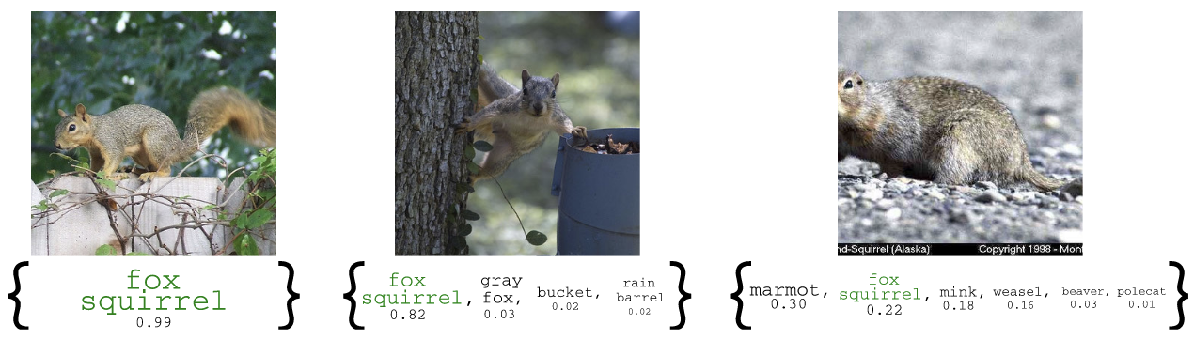
THIRD GENERATION
Risk
Conformal Prediction for calibration
High Confidence
Low Confidence
Paris Carbone
Anastasios N. Angelopoulos and Stephen Bates. 2023. Conformal Prediction: A Gentle Introduction. Found. Trends Mach. Learn. 16, 4 (Mar 2023), 494–591. https://doi.org/10.1561/2200000101
KTH / NYU / TU Wien
Paris Carbone

Slide 87
THIRD GENERATION
Risk
Building a Safety Net
Model-agnostic
Distribution-free
Finite-sample
A GNN, an LLM, or a string matcher is treated as a black box, and never retrained.
No assumption that the data is Gaussian, or i.i.d., or that the model is any good.
A few hundred examples where you know the answer is enough to get started.
From a single answer → to a set that is guaranteed to contain the truth at a rate you choose. The worse the model/harder the mapping, the larger the set.
AND BEYOND COVERAGE — CONFORMAL RISK CONTROL
Bound any risk you can write down. Tumour segmentation: cap the false negatives, and as uncertainty rises the predicted region widens, until it is too wide to act on, and the case goes to a radiologist.
KTH / NYU / TU Wien
Paris Carbone

Slide 88
3
PART 03
Interactive Data Harmonization
Christos Koutras
KTH / NYU / TU Wien
Notes:
The ontologies are already graphs, they should come together, and how we can use the graphs in our advantage
Pitch: standards are a partial solution, graphs don’t solve it entirely, but they are part of the solution
The aim is to simplify the architecture, not radical change (simplify with improving the semantic exchange)

Slide 89




THIRD GENERATION
Interactive Data Harmonisation
From AI-suggested mappings to decisions experts can trust
AI proposes
LLMs facilitate semantic alignment, but a mapping is a decision not a prediction – errors matter
Suggestions must be inspected, validated, and refined by domain experts before they can be trusted.
How to build tools where AI does the heavy lifting, but the experts stay in control?
matchers & LLMs generate candidate mappings, at scale
The expert stays in control
inspect · validate · refine with evidence
A result you can trust
correct, reproducible mappings
AI-based tools should handle the bulk of alignment and disambiguation -
practitioners should retain control over the final results
KTH / NYU / TU Wien
Christos Koutras
89

Slide 90
THIRD GENERATION
What does Harmonisation mean?
Running Example: Pooling cancer cohorts into the NCI Genomics Data Commons (GDC)
10 cancer cohorts — one shown
One target: the Genomic Data Commons (GDC)
Age
Histologic_Grade_FIGO
…
age_at_diagnosis
tumor_grade
…
64
FIGO grade 2
…
23,376
G2
…
71
FIGO grade 3
…
25,933
G3
…
179–213 columns each, own naming & units
700+ attributes with controlled values
1
Schema Matching
2
Value Matching
3
Transformation
Histologic_Grade_FIGO → tumor_grade
FIGO grade 2 → G2
Age 64 (years) → 23,376 (days) ×365.25
KTH / NYU / TU Wien
Christos Koutras
90

Slide 91
THIRD GENERATION
Complexity of Schemata
One source column…
…three plausible GDC targets. Which one?
Histologic_Grade_FIGO
tumor_grade
who_nte_grade
adverse_event_grade
FIGO grade 1
?
G1
G1
Grade 1
FIGO grade 2
G2
G2
Grade 2
FIGO grade 3
G3
G3
Grade 3
…
…
…
…
Each cohort has 179–213 of them, against 700+ GDC attributes: numerous candidate pairs.
!
KTH / NYU / TU Wien
Christos Koutras
91

Slide 92
THIRD GENERATION
Complexity of Values
Age
age_at_diagnosis
age_at_onset
age_at_index
28
?
18250
55
60
59
29220
72
75
76
21915
91
58
Age at diagnosis, in days since birth.
Age when exposure to a specific environmental factor began.
Age in years at the anchor date used for de-identification.
!
Same concept, three encodings — only definitions and values can disambiguate.
KTH / NYU / TU Wien
Christos Koutras
92

Slide 93
THIRD GENERATION
Why Automation Isn't Enough
Nuanced semantics and scale of verification
NUANCED SEMANTICS
SCALE OF VERIFICATION
age_at_diagnosis
Even the best automated matcher (Magneto, VLDB '25) has Recall < 0.5 on GDC mapping
To reach acceptable recall, experts must review top-k lists with a small k
…that is 1000+ candidate matches per dataset!
Today this happens in Excel, R, and unpublished one-off scripts – slow, error-prone, irreproducible
days since birth at diagnosis — e.g. 18250, 29220
age_at_onset
age (in years) when exposure to a specific factor began
age_at_index
age (in years) at the anchor date used for de-identification
!
Only one correct match for Age target attribute
The bottleneck is not generating candidate mappings — it is verifying them. Interactive tools must optimize expert attention, not just model accuracy.
!
KTH / NYU / TU Wien
Christos Koutras
93

Slide 94


THIRD GENERATION
Three Ways to Keep the Expert in Control
Three interaction surfaces, chosen by user and workflow
</>
PARADIGM ①
PARADIGM ②
PARADIGM ③
Harmonization as code
Harmonization as
visual curation
Harmonization as dialogue
Composable primitives inside notebooks and pipelines — scriptable, versionable, reproducible.
The whole candidate space on one screen: overview first, evidence on demand, direct accept / reject.
Agents plan, call the same primitives, self-check — and ask the human when unsure.
for data scientists & pipeline builders
for practitioners who don’t program
for domain experts curating at scale
IN THIS SEGMENT
1
2
3
BDIKit
BDIViz
Three solutions built on one shared backbone
Harmonia
Christos Koutras
KTH / NYU / TU Wien
1​
94

Slide 95
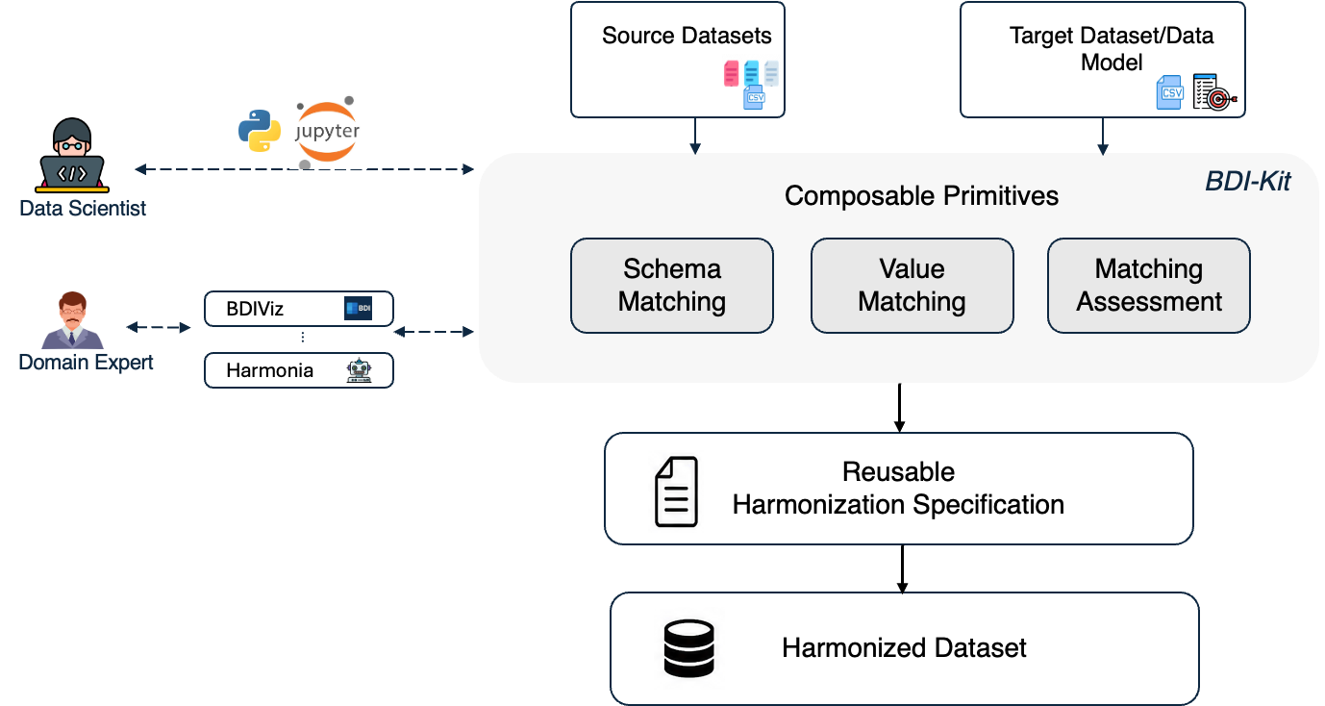
THIRD GENERATION
Shared Harmonization Backbone
Harmonization as code
Harmonization as
visual curation
Harmonization as dialogue
2
3
Christos Koutras
KTH / NYU / TU Wien
1​
95

Slide 96




THIRD GENERATION
BDIKit – Harmonization as Code
Open-source primitives that make each sub-task a one-liner, and the whole workflow a script
import bdikit as bdi
# 1 — schema matching: cohort → GDC
m = bdi.match_schema(df, target="gdc",
method="magneto_ft")
# …expert inspects & repairs a match
bdi.top_matches(df, "Histologic_type",
target="gdc")
# 2 — value matching per attribute pair
v = bdi.match_values(df, target="gdc",
attribute_matches=m, method="tfidf")
# 3 — harmonized table + reusable spec
gdc_df = bdi.materialize_mapping(df, v)
Primitives, not pipelines
Agent-ready via MCP
match_schema · top_matches · match_values · materialize_mapping — compose with pandas.
the same primitives exposed as MCP tools — any AI agent can drive bdi-kit in a chat, model-agnostically.
One API, many matchers
Reproducible by design
Magneto (SLM+LLM), contrastive learning, string & embedding similarity — swap one argument.
declarative JSON mapping specs — rerun on new cohorts, publish with the paper.
Standards built in
target="gdc" loads attribute names, definitions, and permissible values.
!
Verification still means inspecting DataFrames — for 700+ attributes we can do better →
2
3
R. Lopez, A. Santos, C. Koutras, J. Freire — “BDI-Kit”, Patterns (2025) · demo with MCP agents: SIGMOD ’26 · github.com/VIDA-NYU/bdi-kit
Christos Koutras
KTH / NYU / TU Wien
1​
96

Slide 97




THIRD GENERATION
BDIViz: Design Requirements
Each challenge of the task maps to design considerations (DCs) — elicited in interviews and co-design
CHALLENGE
DC1 · Efficient discovery
DC2 · Interactive filtering
Too many candidate pairs
700+ target attributes, deep top-k lists → 1,000+ pairs to review
Surface likely matches automatically — eliminate tedious one-by-one inspection.
Slice the candidate space by ontology group, datatype, and confidence.
CHALLENGE
DC3 · Value-based evidence
DC4 · Agent validation & feedback
Nuanced semantics
names mislead — multiple seemingly equivalent candidates
Show value distributions and comparisons, not just attribute-name similarity.
LLM explanations for candidate matches — validated by the user, folded back into curation.
CHALLENGE
DC5 · Workflow support
Curation is a process
Design lesson: requirements were elicited from failing workflows — then iterated in co-design.
multi-session, multi-source work — mistakes must be reversible
Undo/redo, action timeline, and side-by-side comparison across sources.
2
3
E. Wu et al. — “BDIViz: Interactive Visualization for Biomedical Schema Matching with LLM-Powered Validation”, IEEE TVCG / VIS 2025
Christos Koutras
KTH / NYU / TU Wien
1​
97

Slide 98
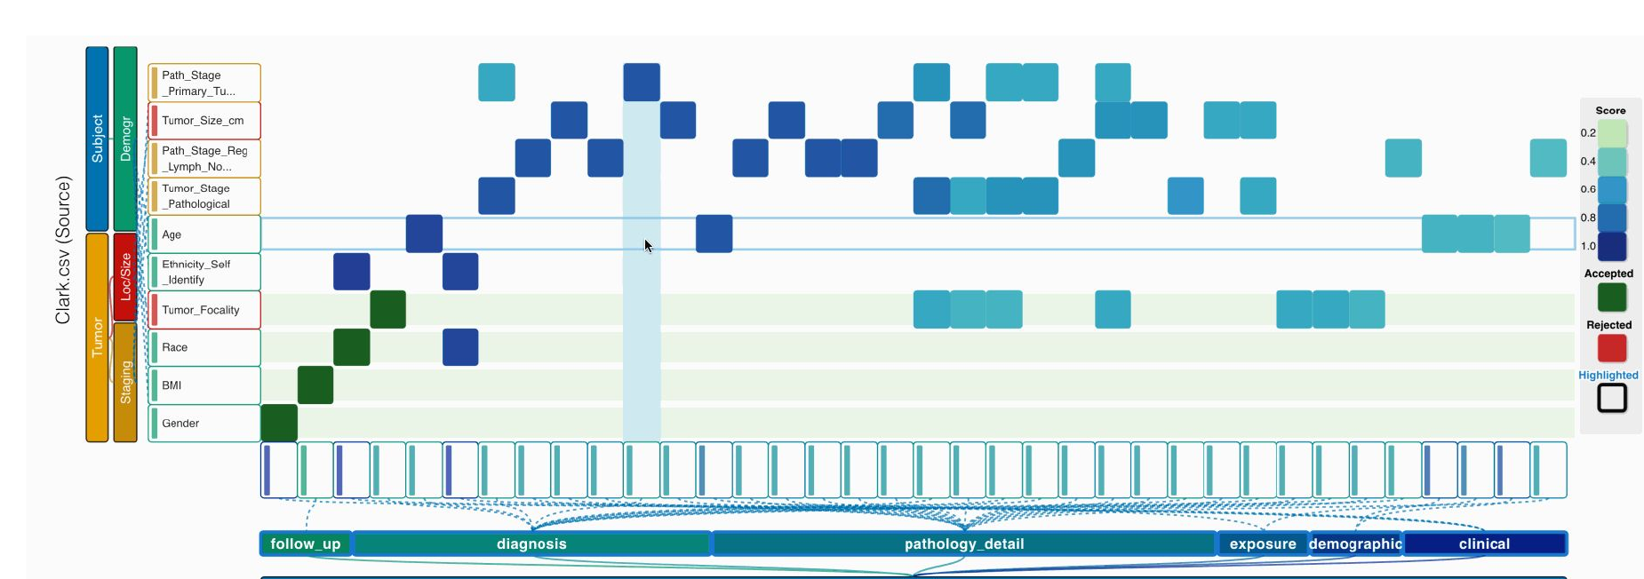




THIRD GENERATION
Candidate Heatmap
Need further inspection
Easy match
2
3
pool many matchers → recall ↑
color = ensemble score → triage hard cases
hierarchical axes: ontology groups of 700+ attrs
green accepted · red rejected
Christos Koutras
KTH / NYU / TU Wien
1​
98

Slide 99
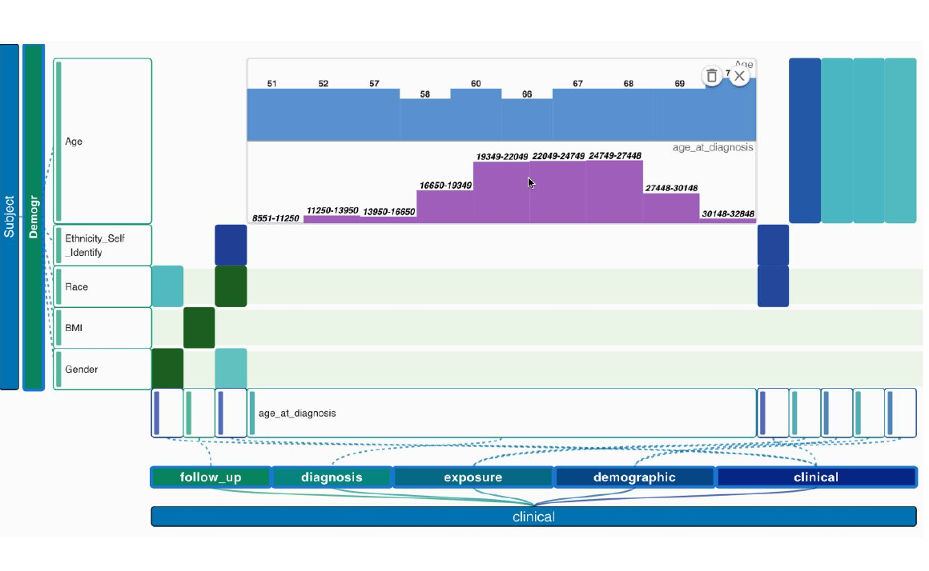
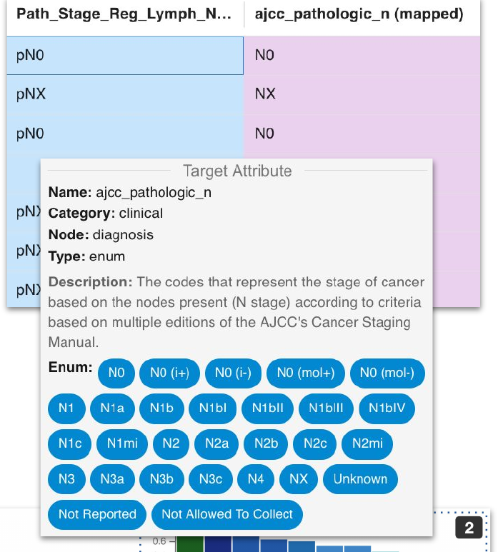
THIRD GENERATION
Per Candidate Evidence
compare value distributions & samples
read definitions and enum domains
accept · reject · edit — inline
value mapping + target definition,
ontology node & permissible values
every action undoable, on a timeline
2
3
Age 51–69 (years) vs age_at_diagnosis 8,551–32,846 (days)
Christos Koutras
KTH / NYU / TU Wien
1​
99

Slide 100

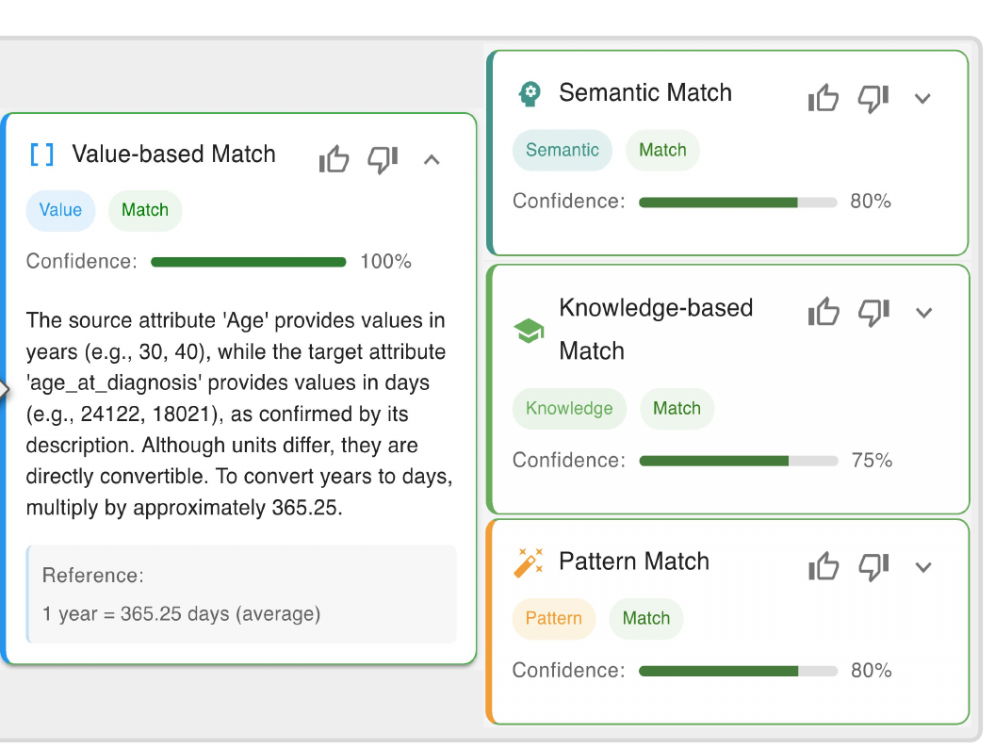

THIRD GENERATION
Validating Candidates with LLM Explanations
Four independent arguments per candidate
Value-based · semantic · knowledge-based · pattern — each with its own confidence score.
Grounded in the data
Explanations cite values and definitions — e.g. years vs. days, convert ×365.25.
Feedback becomes memory
Thumbs-up / thumbs-down and past operations are retrieved to refine later reasoning.
The human still decides
The agent explains and flags — it never commits a mapping on its own.
2
3
Christos Koutras
KTH / NYU / TU Wien
1​
100

Slide 101
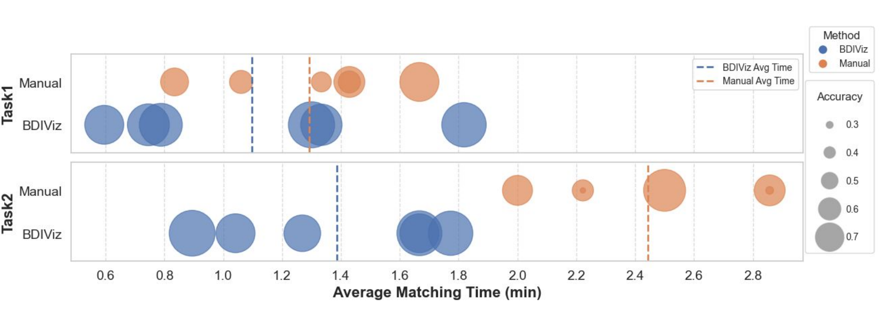
THIRD GENERATION
Evaluation with 12 Domain Experts
↑ accuracy
≈ −40% time
largest gains on abstract names: cT, cM, GN, OS
avg matching time,
Task 2: 2.4 → 1.4 min
SUS 71.9
TLX ↓
Task 1: kidney cohort → GDC (top) · Task 2: lung cohort → PDC (bottom) · bubble size = accuracy
strong perceived usability across participants
lower mental demand, effort & frustration
2
3
Study tasks from Li et al., Cell Rep. Med. 2024 (kidney) and Woldmar et al., ESMO Open 2023 (lung). BDIViz: Wu et al., IEEE TVCG / VIS 2025.
Christos Koutras
KTH / NYU / TU Wien
1​
101

Slide 102




THIRD GENERATION
Route ① BDIKit’s MCP tools — chat from any agent client.
Route ② Harmonia — adds the agent loop, notebook UI, provenance.
Harmonization as Dialogue
BDIKit primitives
Expert
LLM agent
chat / notebook
plan · act · check
generated code
harmonized table
= Harmonia/any MCP client
+ declarative spec
provenance DB — every step logged
example: a Harmonia session
Expert “Match this cohort to GDC using ct_learning.”
Agent match_schema(target="gdc") → flags Histologic_type → roots as suspicious → top_matches() → proposes primary_diagnosis — accept? Expert ✓
Agent match_values() on 8 columns → catches “II” → “Stage III”, corrects to “Stage II” → materialize_mapping() → table + spec
2
3
Santos et al. — “Interactive Data Harmonization with LLM Agents”, NOVAS @ SIGMOD 2025 · BDIKit MCP tools: Lopez et al., SIGMOD ’26 demo
Christos Koutras
KTH / NYU / TU Wien
1​
102

Slide 103

THIRD GENERATION
Design Lessons
AI proposes,
experts dispose
Evidence,
not just scores
Triage expert
attention
Every suggestion is scored; none is committed without a human decision.
Values, distributions, definitions, and explanations at the point of decision.
Route the expert to hard cases — where matchers disagree or confidence is low.
Every decision
leaves a trace
One backbone,
many surfaces
Provenance + declarative specs → reproducible, reusable, publishable mappings.
Code, visual, conversational — same primitives; meet users where they work.
2
3
Christos Koutras
KTH / NYU / TU Wien
1​
103

Slide 104
4
PART 04
The New Frontier
Andra Ionescu, Paris Carbone, Christos Koutras, Katja Hose, Jayanth Raghotama
KTH / NYU / TU Wien

Slide 105
THE NEW FRONTIER
Open Problems
What is still missing between a score and a guarantee
1
Nobody has done this for alignment
The graph, LLM and imaging literatures all have conformal methods. Ontology and schema matching have scores, top-k lists and ensemble ranks. and no coverage guarantee.
2
Who produces the calibration set?
Coverage needs ground truth. 500 verified SKS→SNOMED mappings, at whose cost and can that set be shared when the underlying records cannot?
3
Marginal coverage is not conditional coverage
90% overall is compatible with 40% on rare disease codes , exactly the codes that matter. Mondrian CP helps; full conditional coverage is provably impossible.
4
Expert feedback breaks the assumption
The moment corrections re-enter the calibration set, the data stop being exchangeable, and the interactive designs that follow depend on that loop.
5
Cohort Statistics as a goal
Prediction-powered inference (Science, 2023) gives valid confidence intervals from a small verified sample plus a large machine-labelled one which may matter more than getting every code right.
KTH / NYU / TU Wien
Paris Carbone
105

Slide 106




THE NEW FRONTIER
Open Problems in Interactive Harmonization
Benchmarks for interactive harmonization*
Calibrated uncertainty
Reproducibility vs. LLM brittleness
End-to-end evaluation of human+AI workflows — beyond isolated matching metrics.
Expose confidence users can act on — it decides when the human is called.
Same prompt, different run. Specs + provenance help — guarantees don’t exist yet.
Interaction design
Provenance-aware agents
NL is ambiguous: blend dialogue with structured, action-oriented interfaces.
Learn user preferences from curation history; explain any output’s lineage.
2
3
*Santos, A. et. al (2025). GDC-SM: The GDC Schema Matching Benchmark (Version 1.0) [Dataset]. Zenodo. https://doi.org/10.5281/zenodo.14963588
Christos Koutras
KTH / NYU / TU Wien
1​
106

Slide 107
THE NEW FRONTIER
Open Problems
1
Provenance tracking
Mapping provenance, data provenance
2
Federated, privacy preserving mapping
Multi-site clinical data
3
Quantifying semantic loss
What is the value of the data that is not mapped?
KTH / NYU / TU Wien
Andra Ionescu
107

Slide 108
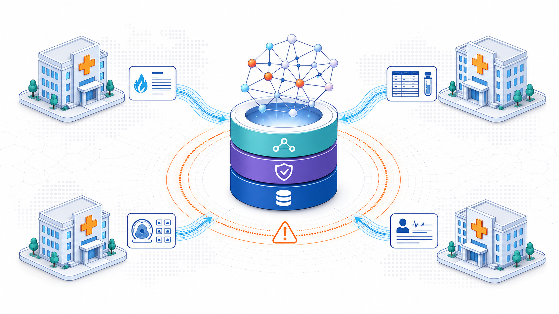
THE NEW FRONTIER
Traditional Health Data Integration
Central component
Single point of failure
Mapping data to a common schema
Data harmonization and imputation
Ontology-based data access
Knowledge graphs
KTH / NYU / TU Wien
Katja Hose
108

Slide 109
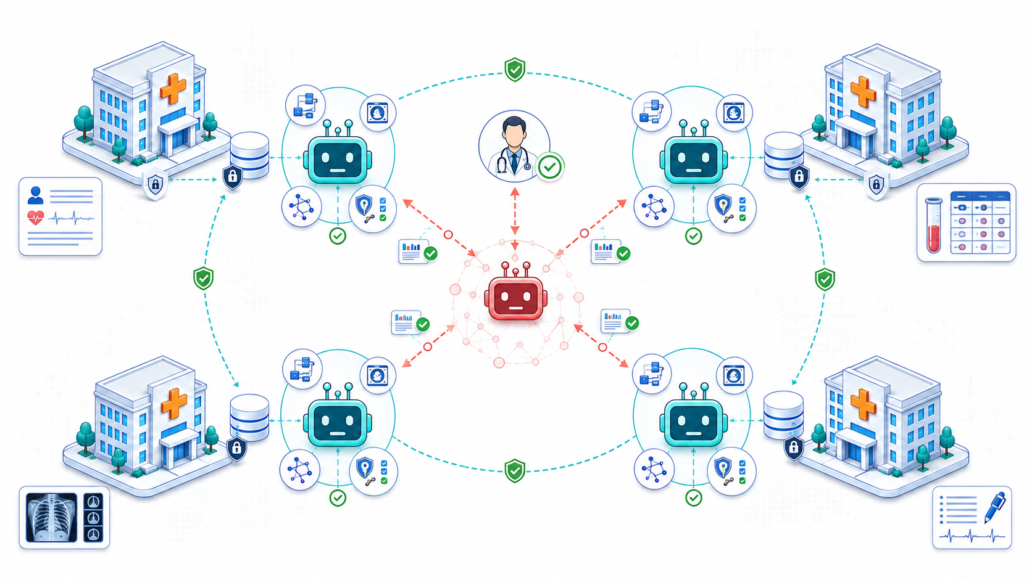
THE NEW FRONTIER
Agents in Healthcare
Central component
Distributed system
Collaboration and negotiation to achieve tasks
Intelligently combine different skills and specialization
Automatically align understanding
Knowledge graphs
Multi-modality
KTH / NYU / TU Wien
Katja Hose
109

Slide 110
THE NEW FRONTIER
Conclusion
Why this matters
1
Beyond Technology and Research
Improvement in data exchange can, and will lead to a tangible improvement in the delivery of care and outcomes for patients
2
Data Quality
Better models, reduced data needs AND improvement in patient outcomes
3
True Interoperability
Can only come from the domain agreeing on semantics
4
But until then
Technology can fill the gaps, improve interoperability systems
KTH / NYU / TU Wien
Jayanth Raghothama
110

